Slide 1
A Graphical and Generalized Linear Model Approach to Latent Variable Modeling
Frank Rijmen, AIR

Slide 2
What this presentation is about
Graphical models
Efficient computation
Substantive knowledge
Model structure
Generalized linear models
Modeling conditional probabilities

Slide 3
1. Substantive Knowledge: Model Structure
Latent variables are widely used in the behavioral and social sciences
  To explain the statistical dependencies among a set of observed variables
  The latent structure is often of primary interest
Interest in relatively complex (= many latent variables) models
Models are inspired by substantive theories, and hence differ from application to application
Examples
  Discrete latent variables, representing emotional states, to model between-and within-person differences in responses to questions about the presence of emotions
  Discrete and continuous latent variables to model illness progression
  Hierarchical and higher-order models in educational measurement
    Including third-order/trifactor models and two-tier models

Slide 4
1. Substantive Knowledge: Model Structure
Latent variables are widely used in the behavioral and social sciences
  To explain the statistical dependencies among a set of observed variables
  The latent structure is often of primary interest
Interest in relatively complex (= many latent variables) models
Models are inspired by substantive theories, and hence differ from application to application
Examples
  Discrete latent variables, representing emotional states, to model between-and within-person differences in responses to questions about the presence of emotions
  Discrete and continuous latent variables to model illness progression
  Hierarchical and higher-order models in educational measurement
    Including third-order/trifactor models and two-tier models

Slide 6
1. Substantive Knowledge: Model Structure
Latent variables are widely used in the behavioral and social sciences
  To explain the statistical dependencies among a set of observed variables
  The latent structure is often of primary interest
Interest in relatively complex (= many latent variables) models
Models are inspired by substantive theories, and hence differ from application to application
Examples
  Discrete latent variables, representing emotional states, to model between-and within-person differences in responses to questions about the presence of emotions
  Discrete and continuous latent variables to model illness progression
  Hierarchical and higher-order models in educational measurement
    Including third-order/trifactor models and two-tier models

Slide 8
1. Substantive Knowledge: Model Structure
Latent variables are widely used in the behavioral and social sciences
  To explain the statistical dependencies among a set of observed variables
  The latent structure is often of primary interest
Interest in relatively complex (= many latent variables) models
Models are inspired by substantive theories, and hence differ from application to application
Examples
  Discrete latent variables, representing emotional states, to model between-and within-person differences in responses to questions about the presence of emotions
  Discrete and continuous latent variables to model illness progression
  Hierarchical and higher-order models in educational measurement
    Including third-order/trifactor models and two-tier models

Slide 10
The Challenge
Practioners need a general estimation framework that produces accurate results in limited time
For continuous (normally distributed) variables, such a framework exists: structural equation models
For categorical data, it does not
  Maximum likelihood estimation involves numerical integration over the latent space
    All latent variables are treated to be discrete
  Number of computations in brute force integration is exponential in the number of latent variables (not in limited time)
  The quality of approximative estimation techniques is often questionable (not accurate)
  Bayesian estimation in itself is not a solution (not in limited time)
  More efficient ML techniques are developed for specific models (not general)

Slide 11
Graphical models
Efficient computation
Substantive knowledge
Model structure
Generalized linear models
Modeling conditional probabilities

Slide 12
2. Graphical models: Efficient Computation
For any of the models presented, brute force integrations can be avoided
Exploitation of the conditional independence relations implied by the models
Underlying principle: Multiplication is distributive over addition
  a(b+c)= ab+ac

Slide 13
2. Graphical models: Efficient Computation
Or in this context

Slide 14
2. Graphical models: Efficient Computation
We could spend the rest of this presentation showing how this is instantiated for each of the models presented as illustrations
However:
Graphical models provide a general and efficient way to organize the order of multiplications and summations
  Separation in the graph corresponds to conditional independence
  Graphs are formal structures on which algorithms can operate
  No need for tedious, error-prone derivations for every “new” model
  (as if there is a finite number of possible models)

Slide 15
2. Graphical models: Efficient Computation
Principle
  Break a complex model down into manageable pieces whenever possible
  Exploiting conditional independence relations
Steps
  Statistical model is represented in a (directed acyclic) graph
  Graph is transformed
  Efficient computational schemes are defined on the transformed graph

Slide 16
Graphical models
Efficient computation
Substantive knowledge
Model structure
Generalized linear models
Modeling conditional probabilities

Slide 17
3. Generalized Linear Models: Modeling Conditional Probabilities
In the graphical model literature
  Focus is on efficient ‘propagation of evidence’
  Not so much on defining a parametric (sub)model for each variable

Slide 18
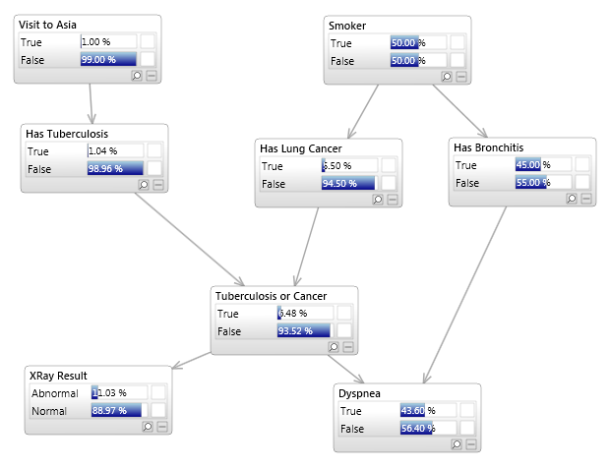

Slide 19
3. Generalized Linear Models: Modeling Conditional Probabilities
Integrate GLM theory with a graphical model framework
  Every node is modeled as a GLM, conditional on the ‘parent’ variables in the graph
  Generalized linear models are flexible tools for defining parametric models
    Statistical properties are well understood
    Estimation methods are established
  GLMs in themselves are modular
    Probability distribution
    Linear predictor
    Link function

Slide 20
3. Generalized Linear Models: Modeling Conditional Probabilities
Some advantages of specifying a GLM for each variable
  Parsimony (number of probabilities increases exponentially in the number of parent variables under a saturated model)
    Saturated model as special case
  Covariates can be included in a natural way
  Ordered categorical variables
  Parameters can be shared across models for the individual variables
  Linear constraints (including equality constraints) can be specified easily
  Parameters can be fixed to specific values

Slide 21
3. Generalized Linear Models: Modeling Conditional Probabilities
Some advantages of specifying a GLM for each variable (continued)
  Priors (Bayes modal estimation)
  State-of-the-art integration over random effects (GLMMS)
  Due to the modularity of GLMs, extensions can be incorporated easily
    Nonlinear predictors

Slide 22
Graphical models
Efficient computation
Substantive knowledge
Model structure
Generalized linear models
Modeling conditional probabilities

Slide 23
Advantages of an Integrated Approach
Flexibility
It forces one to work out general solutions that often work better than customized approaches applied to scaled-up problems
  For customized approaches, it is almost by definition hard to forecast what future applications will call for
  A lot of things do not matter until they do
    See second part of this presentation
  The cost of general approaches is often low if using the right tools
    For example: sparse matrices
  Special cases can always be defined as a ‘layer’ on top of a more general approach

Slide 24
Case Study: NGSS

Slide 25
The Next Generation of Science Standards
NGSS provides a three-dimensional paradigm for learning science
  Crosscutting concepts (CCC) across four disciplines of science: Physical Science, Life Science, Earth and Space Science, and Engineering Design.
  Science and Engineering Practices (SEP) which describes what scientists do to investigate the natural world and what engineers do to use science to design and build systems.
  Disciplinary Core Ideas (DCIs) which are the key ideas in science that are important across all science and engineering disciplines

Slide 26
Assessing the NGSS with Clusters
Standards are combination of the three dimensions
  Called ‘performance expectations’
Performance expectations are assessed through more traditional ‘stand-alone’ items and clusters
Clusters
  Developed around a scientific phenomenon
  Designed to assess the full breadth of a performance expectation
  Take about 10-12 minutes
  Involve multiple interactions
  Scaffolded

Slide 27
Assessing the NGSS with Clusters
https://demo.tds.airast.org/ngss/

Slide 28
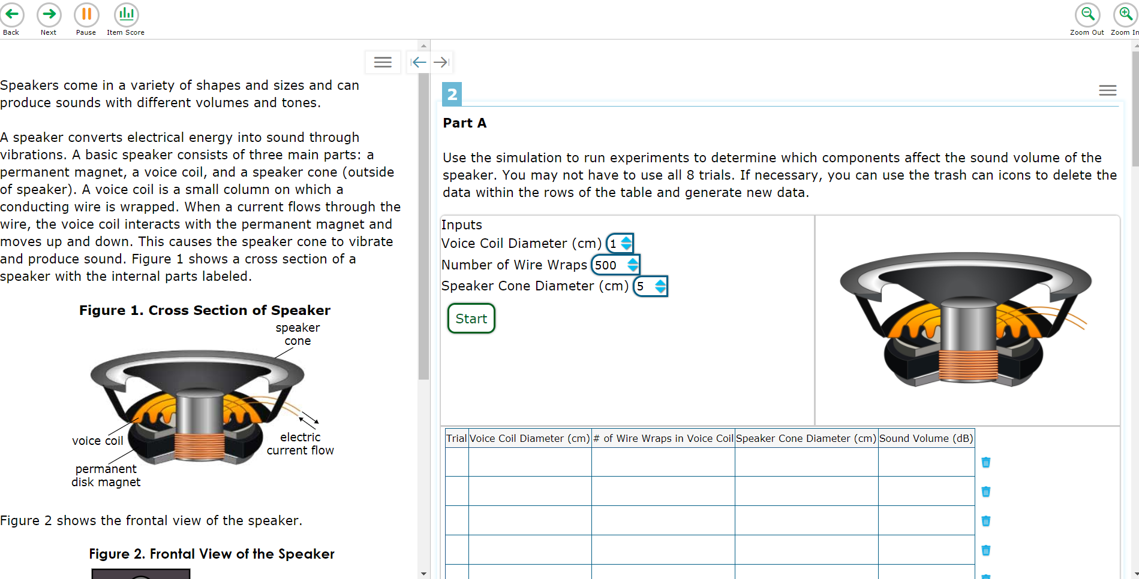

Slide 29
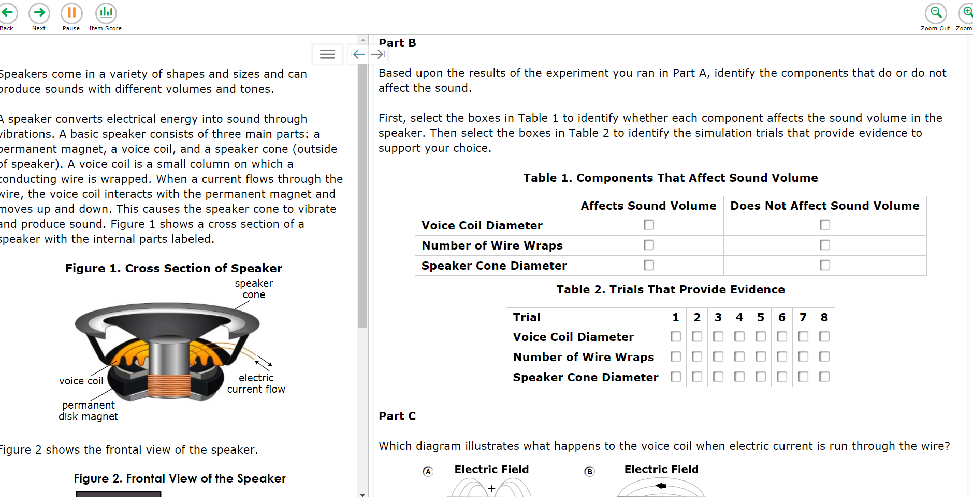
Scoring Assertions

Slide 30
Scoring Assertions
Within each item cluster, a series of explicit assertions can be made about the knowledge and skills that a student has demonstrated based on specific features of the student’s responses
Scoring assertions can be supported based on students’ responses in one or more interactions within an item cluster.
Dependent scoring
Scoring assertions are the basic units of analysis

Slide 31
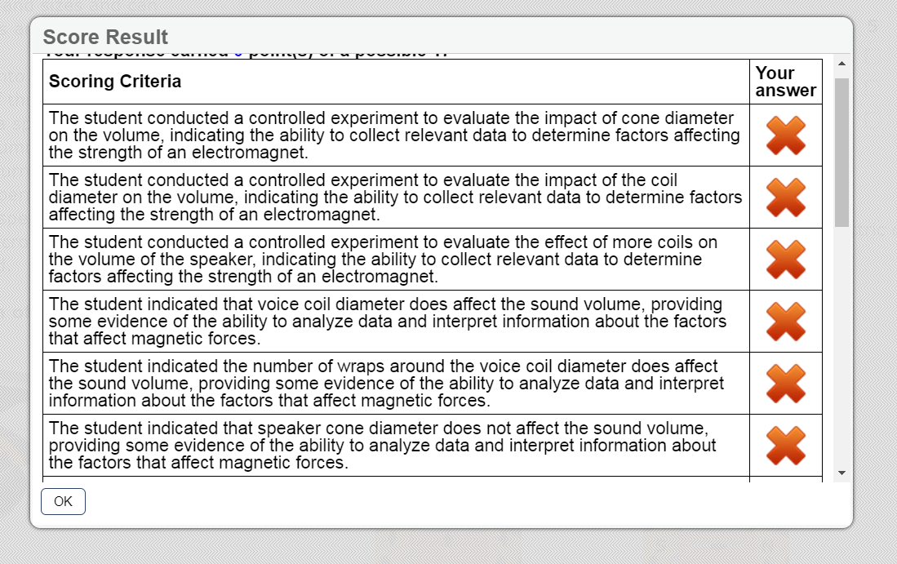

Slide 32
Common Field Test
In Spring 2018, items were administered in:
  Connecticut (independent field test)
  Hawaii (embedded field test)
  New Hampshire (operational field test)
  Oregon (embedded field test)
  Rhode Island (independent field test)
  Utah (operational field test)
  Vermont (operational field test)
  West Virginia (operational field test)
  Wyoming (embedded field test)

Slide 33
Common Field Test
Incomplete data collection designs
  Balanced incomplete (fixed form)
  Linear on the fly

Slide 34
Common Items Across States
150+ clusters and 200+ items in total for MS

Slide 35
IRT Calibration
Traditional unidimensional IRT models assume conditional independence
  All correlations between item responses are accounted for by a single proficiency variable
It is unlikely that this assumption will hold for NGSS assessments
  We expect stronger correlations between assertions pertaining to the same cluster than between assertions from different clusters
$$P\left(x | θ\right)=\prod_{j=1}^{n}{P\left(x_{j}|θ\right)}$$

Slide 36
IRT Calibration
Ignoring item clustering effects results in
  Biased item parameter estimates
  Biased ability estimates
  Underestimation of the standard errors of measurements
One approach, followed in traditional assessments with item clusters (e.g., passages in ELA), is to minimize dependencies during item construction and to ignore remaining statistical dependencies
This does not work for NGSS assessments

Slide 37
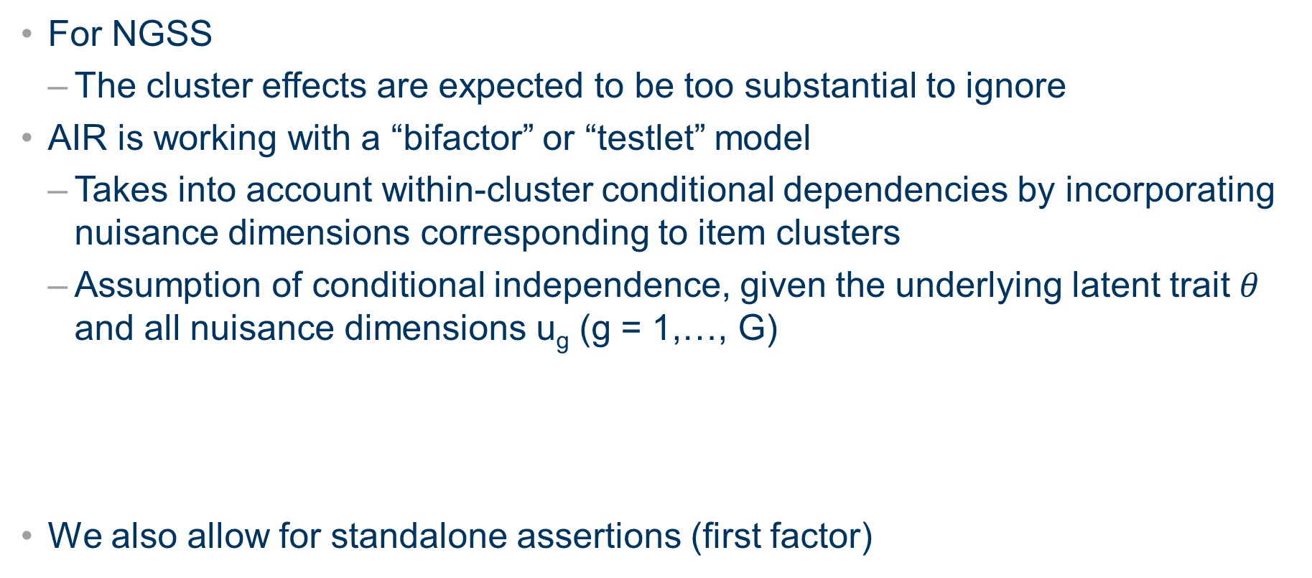
IRT Calibration
For NGSS
  The cluster effects are expected to be too substantial to ignore
AIR is working with a “bifactor” or “testlet” model
  Takes into account within-cluster conditional dependencies by incorporating nuisance dimensions corresponding to item clusters
  Assumption of conditional independence, given the underlying latent trait $θ$ and all nuisance dimensions u_{g} (g = 1,…, G)
We also allow for standalone assertions (first factor)
$$P\left(x | θ,u\right)=\prod_{j∈SA}{P\left(x_{j}|θ\right)}\prod_{g=1}^{G}{\prod_{j∈g}{P\left(x_{jg}|θ,u_{g}\right)}}$$

Slide 38
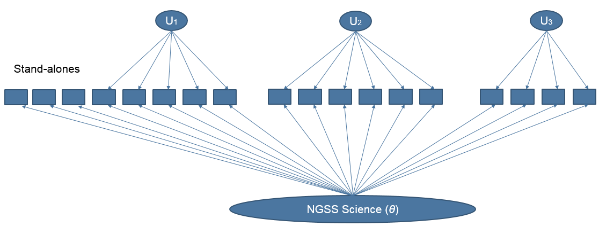
IRT Calibration

Slide 39
IRT Calibration
Specifically, AIR is currently working with the 1PL version of the bifactor model (Wang & Wilson, 2005):
We are not trying to disentangle the three dimensions of science
  With a reasonable number of items and these dimensions likely correlated, it would be very hard to disentangle the 3 dimensions
  Three dimensions should be taught and assessed together, why would you report them out in isolation?
$$P\left(x_{jg}=1|θ,u_{g};b_{j}\right)=\frac{exp\left(θ+u_{g}−b_{j}\right)}{1+exp\left(θ+u_{g}−b_{j}\right)}$$

Slide 40
IRT Calibration
Joint calibration with overall group differences taken into account
  Group-specific mean and variance for the overall science proficiency
Advantages of joint calibration
  More efficient than post-equating methods
    Item parameters are based on student responses from multiple states
  Differences in mean and variance of the overall proficiency between states/grades are taken into account, just like post-equating methods do
The result is a common item bank on a (robust) common scale

Slide 41
IRT Calibration
Clear example where all 3 components of the integrated approach play a role
Model structure
  Interest in measuring overall science
  Presence of local dependencies (item cluster effects)
Modeling conditional probabilities
  1PL formulation
  Group effects
Efficient computation
  150+ dimensional space, but computations can be carried out in two-dimensional subspaces

Slide 43
IRT Calibration
BNL toolbox
  Less than one day
Flexmirt
  6 weeks
    After providing it with the BNL output as starting values
    After fixing 2 clusters to BNL estimates

Slide 44
If you have questions or comments: frijmen@air.org

