Slide 1
Modeling student choices within complex tasks using Markov decision processes
Michelle LaMar
mlamar@ets.org
Educational Testing Service
MARC, Nov 2nd 2018

Slide 2
Talk Outline
Framing the Problem
Science Simulation Task
Process data and Evidence Extraction
Method and Statistics
Decision Models and
Psychometric Inference
Results and Conclusions
Revisit our example
Limitations and Next Steps
Markov Decision Processes

Slide 3
Simulation-based Science Assessment
Item Prompt:
Does the concentration of a drink mix solution increase when you increase the amount of drink mix in the container?
Run trials with the simulation to answer this question.

Slide 5
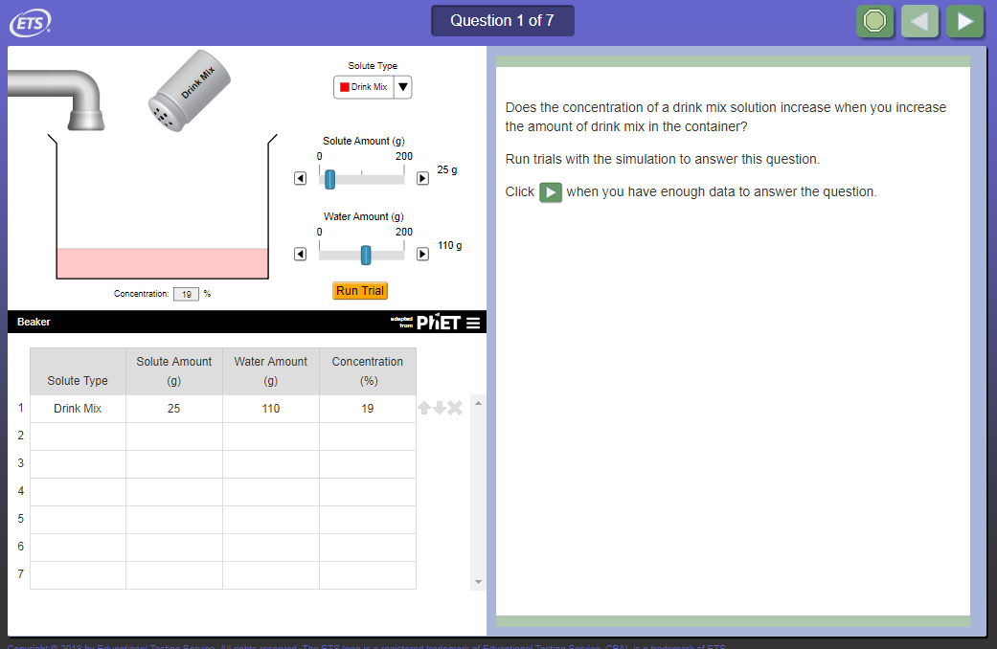

Slide 8
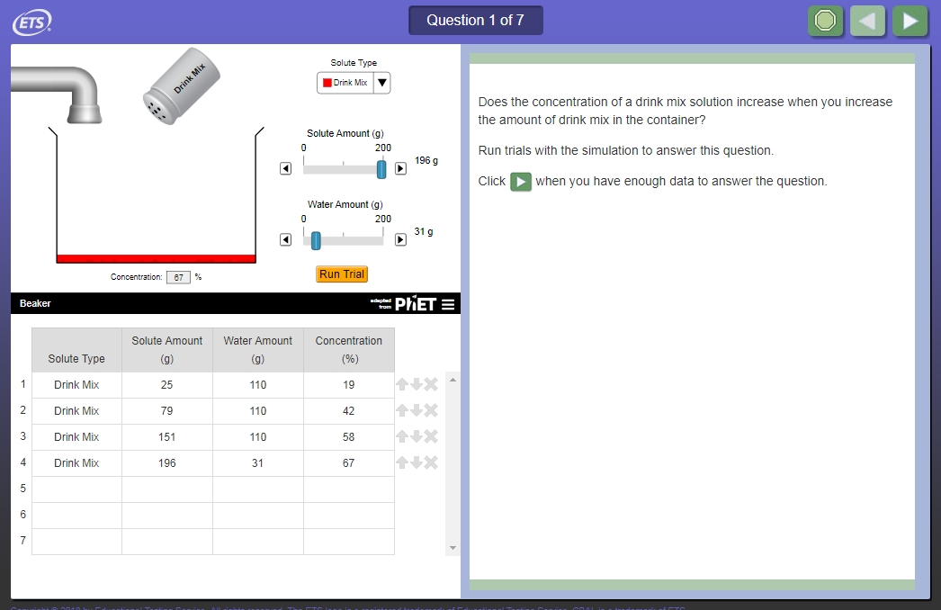

Slide 9
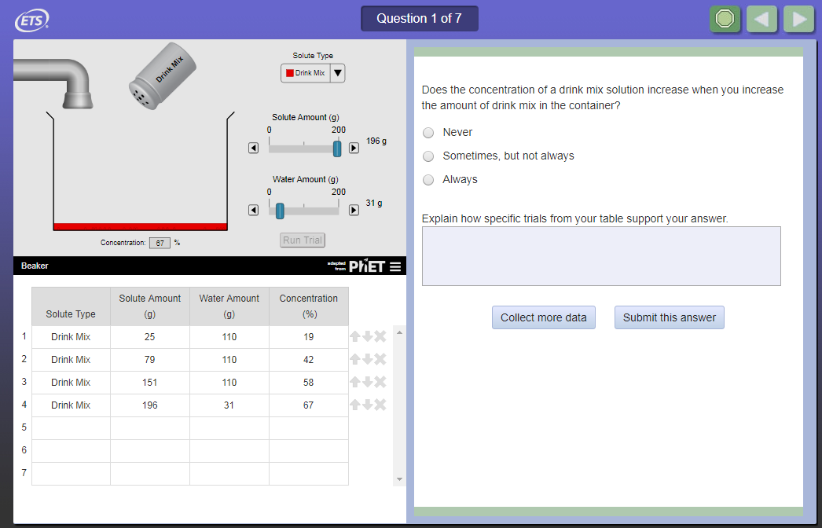

Slide 10
Performance Tasks
Showing not telling:
Emphasize actively demonstrating skills
Evidence for the constructs are in the way the task is accomplished
Outcome data has limited utility
Scoring Process Data is non trivial:
Value of an action depends on its place in a larger plan
Multiple correct strategies
Missteps or problem-space exploration not necessarily bad

Slide 11
Performance Data Log File
Student FB5K6K5BI Question 7
ran [trial] with [solute type] [solute amount] [solvent amount] resulting in [concentration] |  | 42 | Drink Mix | 51 | 102 | 33
ran [trial] with [solute type] [solute amount] [solvent amount] resulting in [concentration] |  | 43 | Drink Mix | 105 | 102 | 51
ran [trial] with [solute type] [solute amount] [solvent amount] resulting in [concentration] |  | 44 | Drink Mix | 164 | 102 | 62
ran [trial] with [solute type] [solute amount] [solvent amount] resulting in [concentration] |  | 45 | Drink Mix | 51 | 153 | 25
ran [trial] with [solute type] [solute amount] [solvent amount] resulting in [concentration] |  | 46 | Drink Mix | 101 | 153 | 40
ran [trial] with [solute type] [solute amount] [solvent amount] resulting in [concentration] |  | 47 | Drink Mix | 167 | 153 | 52
ran [trial] with [solute type] [solute amount] [solvent amount] resulting in [concentration] |  | 48 | Drink Mix | 52 | 90 | 37
ran [trial] with [solute type] [solute amount] [solvent amount] resulting in [concentration] |  | 49 | Drink Mix | 102 | 90 | 53
ran [trial] with [solute type] [solute amount] [solvent amount] resulting in [concentration] |  | 50 | Drink Mix | 170 | 90 | 65
ran [trial] with [solute type] [solute amount] [solvent amount] resulting in [concentration] |  | 51 | Drink Mix | 54 | 47 | 53
ran [trial] with [solute type] [solute amount] [solvent amount] resulting in [concentration] |  | 52 | Drink Mix | 104 | 47 | 67
ran [trial] with [solute type] [solute amount] [solvent amount] resulting in [concentration] |  | 53 | Drink Mix | 200 | 47 | 67
clicked collect more data button
ran [trial] with [solute type] [solute amount] [solvent amount] resulting in [concentration] |  | 54 | Drink Mix | 46 | 18 | 67
ran [trial] with [solute type] [solute amount] [solvent amount] resulting in [concentration] |  | 55 | Drink Mix | 94 | 18 | 67
ran [trial] with [solute type] [solute amount] [solvent amount] resulting in [concentration] |  | 56 | Drink Mix | 200 | 18 | 67
'entered text box with [response] in [item]' | In most trials, the concentration increased with the drink mix, but when there was little water, the concentration never went above 67%

Slide 12
Performance Data Log File
Solute
Concent.
Water
ran trial | 42 | Drink Mix | 51 | 102 | 33
ran trial | 43 | Drink Mix | 105 | 102 | 51
ran trial | 44 | Drink Mix | 164 | 102 | 62
ran trial | 45 | Drink Mix | 51 | 153 | 25
ran trial | 46 | Drink Mix | 101 | 153 | 40
ran trial | 47 | Drink Mix | 167 | 153 | 52
ran trial | 48 | Drink Mix | 52 | 90 | 37
ran trial | 49 | Drink Mix | 102 | 90 | 53
ran trial | 50 | Drink Mix | 170 | 90 | 65
ran trial | 51 | Drink Mix | 54 | 47 | 53
ran trial | 52 | Drink Mix | 104 | 47 | 67
ran trial | 53 | Drink Mix | 200 | 47 | 67
more data button
ran trial | 54 | Drink Mix | 46 | 18 | 67
ran trial | 55 | Drink Mix | 94 | 18 | 67
ran trial | 56 | Drink Mix | 200 | 18 | 67

Slide 13
Evidence Extraction from Log Data
Aggregate Action Counts
Solute
Concent.
Water
ran trial | 42 | Drink Mix | 51 | 102 | 33
ran trial | 43 | Drink Mix | 105 | 102 | 51
ran trial | 44 | Drink Mix | 164 | 102 | 62
ran trial | 45 | Drink Mix | 51 | 153 | 25
ran trial | 46 | Drink Mix | 101 | 153 | 40
ran trial | 47 | Drink Mix | 167 | 153 | 52
ran trial | 48 | Drink Mix | 52 | 90 | 37
ran trial | 49 | Drink Mix | 102 | 90 | 53
ran trial | 50 | Drink Mix | 170 | 90 | 65
ran trial | 51 | Drink Mix | 54 | 47 | 53
ran trial | 52 | Drink Mix | 104 | 47 | 67
ran trial | 53 | Drink Mix | 200 | 47 | 67
more data button
ran trial | 54 | Drink Mix | 46 | 18 | 67
ran trial | 55 | Drink Mix | 94 | 18 | 67
ran trial | 56 | Drink Mix | 200 | 18 | 67
15 Trials
1 Collect More Data
0 Deletions

Slide 14
Evidence Extraction from Log Data
Aggregate Feature Counts
Solute
Concent.
Water
ran trial | 42 | Drink Mix | 51 | 102 | 33
ran trial | 43 | Drink Mix | 105 | 102 | 51
ran trial | 44 | Drink Mix | 164 | 102 | 62
ran trial | 45 | Drink Mix | 51 | 153 | 25
ran trial | 46 | Drink Mix | 101 | 153 | 40
ran trial | 47 | Drink Mix | 167 | 153 | 52
ran trial | 48 | Drink Mix | 52 | 90 | 37
ran trial | 49 | Drink Mix | 102 | 90 | 53
ran trial | 50 | Drink Mix | 170 | 90 | 65
ran trial | 51 | Drink Mix | 54 | 47 | 53
ran trial | 52 | Drink Mix | 104 | 47 | 67
ran trial | 53 | Drink Mix | 200 | 47 | 67
more data button
ran trial | 54 | Drink Mix | 46 | 18 | 67
ran trial | 55 | Drink Mix | 94 | 18 | 67
ran trial | 56 | Drink Mix | 200 | 18 | 67
15 Trials
1 Collect More Data
0 Deletions
10 VOTAT Trials (71%)

Slide 15
Evidence Extraction
Concent.
Solute
Water
ran trial | 55 | Drink Mix | 21 | 0 | -
Delete Trial | 55
ran trial | 56 | Drink Mix | 21 | 200 | 10
ran trial | 57 | Drink Mix | 46 | 200 | 19
ran trial | 58 | Drink Mix | 78 | 177 | 31
ran trial | 59 | Drink Mix | 110 | 155 | 42
Delete Trial | 58
Delete Trial | 59
ran trial | 60 | Drink Mix | 69 | 200 | 26
ran trial | 61 | Drink Mix | 89 | 200 | 31
ran trial | 62 | Drink Mix | 110 | 200 | 35
ran trial | 63 | Drink Mix | 134 | 200 | 40
ran trial | 64 | Drink Mix | 166 | 200 | 45
ran trial | 65 | Drink Mix | 200 | 200 | 50
more data button | NA | Drink Mix | NA | NA | NA
ran trial | 66 | Drink Mix | 200 | 19 | 67
more data button
ran trial | 67 | Drink Mix | 19 | 19 | 50
ran trial | 68 | Drink Mix | 19 | 6 | 67
ran trial | 69 | Drink Mix | 200 | 1 | 67
Solute
Concent.
Water
ran trial | 42 | Drink Mix | 51 | 102 | 33
ran trial | 43 | Drink Mix | 105 | 102 | 51
ran trial | 44 | Drink Mix | 164 | 102 | 62
ran trial | 45 | Drink Mix | 51 | 153 | 25
ran trial | 46 | Drink Mix | 101 | 153 | 40
ran trial | 47 | Drink Mix | 167 | 153 | 52
ran trial | 48 | Drink Mix | 52 | 90 | 37
ran trial | 49 | Drink Mix | 102 | 90 | 53
ran trial | 50 | Drink Mix | 170 | 90 | 65
ran trial | 51 | Drink Mix | 54 | 47 | 53
ran trial | 52 | Drink Mix | 104 | 47 | 67
ran trial | 53 | Drink Mix | 200 | 47 | 67
more data button
ran trial | 54 | Drink Mix | 46 | 18 | 67
ran trial | 55 | Drink Mix | 94 | 18 | 67
ran trial | 56 | Drink Mix | 200 | 18 | 67
15 Trials
1 Collect More Data
0 Deletions
10 VOTAT Trials (71%)
15 Trials
2 Collect More Data
3 Deletions
10 VOTAT Trials (71%)

Slide 16
Evidence Extraction
Solute
Concent.
Water
Solute
Concent.
Water
ran trial | 55 | Drink Mix | 21 | 0 | -
ran trial | 56 | Drink Mix | 21 | 200 | 10
ran trial | 57 | Drink Mix | 46 | 200 | 19
ran trial | 58 | Drink Mix | 78 | 177 | 31
ran trial | 59 | Drink Mix | 110 | 155 | 42
ran trial | 60 | Drink Mix | 69 | 200 | 26
ran trial | 61 | Drink Mix | 89 | 200 | 31
ran trial | 62 | Drink Mix | 110 | 200 | 35
ran trial | 63 | Drink Mix | 134 | 200 | 40
ran trial | 64 | Drink Mix | 166 | 200 | 45
ran trial | 65 | Drink Mix | 200 | 200 | 50
more data button
ran trial | 66 | Drink Mix | 200 | 19 | 67
more data button
ran trial | 67 | Drink Mix | 19 | 19 | 50
ran trial | 68 | Drink Mix | 19 | 6 | 67
ran trial | 69 | Drink Mix | 200 | 1 | 67
ran trial | 42 | Drink Mix | 51 | 102 | 33
ran trial | 43 | Drink Mix | 105 | 102 | 51
ran trial | 44 | Drink Mix | 164 | 102 | 62
ran trial | 45 | Drink Mix | 51 | 153 | 25
ran trial | 46 | Drink Mix | 101 | 153 | 40
ran trial | 47 | Drink Mix | 167 | 153 | 52
ran trial | 48 | Drink Mix | 52 | 90 | 37
ran trial | 49 | Drink Mix | 102 | 90 | 53
ran trial | 50 | Drink Mix | 170 | 90 | 65
ran trial | 51 | Drink Mix | 54 | 47 | 53
ran trial | 52 | Drink Mix | 104 | 47 | 67
ran trial | 53 | Drink Mix | 200 | 47 | 67
more data button
ran trial | 54 | Drink Mix | 46 | 18 | 67
ran trial | 55 | Drink Mix | 94 | 18 | 67
ran trial | 56 | Drink Mix | 200 | 18 | 67

Slide 17
Evidence Extraction from Log Data
Standard Feature/Behavior Identification:
-Designed detectors (patterns specified by content experts)
-Machine learned detectors (data mining)
Proposed Feature/Behavior Identification:
-Probabilistic decision models of the behavior

Slide 18
Models of Decision Making

Slide 19
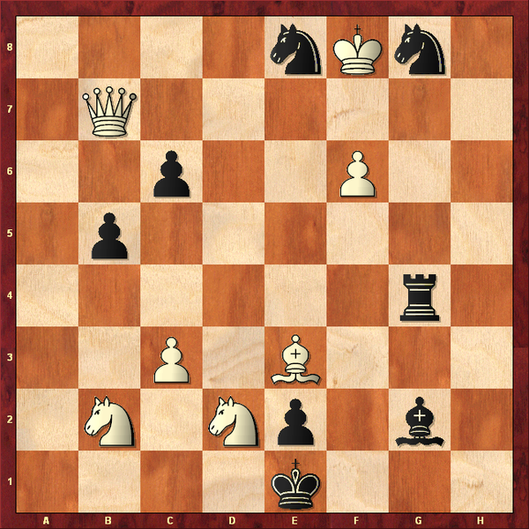
Decision Models
White’s move.

Slide 20
Decision Models
$$p\left(a | s,ξ\right)=f(\text{The} \text{value} \text{of} \text{action} \text{a})$$

Slide 21
Decision Models
$$p\left(a | s,ξ\right)=f(\text{The} \text{value} \text{of} \text{action} \text{a})$$
Expected Total Rewards

Slide 22
Decision Models
$$p\left(a | s,ξ\right)=f(\text{The} \text{value} \text{of} \text{action} \text{a})$$
Immediate Benefit
Immediate Cost
Expected Future Net Rewards

Slide 23
Markov Decision Process (MDP)
The expected rewards for taking action $a$ in state $s$ is expressed by the Q-function (Bellman, 1957):
$$Q\left(s,a\right)=\sum_{s^{′}∈ S}{p\left(s^{′} | s,a\right)\left(R\left(s,a,s^{′}\right)+γ\sum_{a′∈A}{p\left(a′ | s′\right)Q\left(s′,a′\right)}\right)}$$

Slide 24
Markov Decision Process (MDP)
The expected rewards for taking action $a$ in state $s$ is expressed by the Q-function (Bellman, 1957):
$$Q\left(s,a\right)=\sum_{s^{′}∈ S}{p\left(s^{′} | s,a\right)\left(R\left(s,a,s^{′}\right)+γ\sum_{a′∈A}{p\left(a′ | s′\right)Q\left(s′,a′\right)}\right)}$$
Value of choosing action $a$ in state $s$
Transition probability
Immediate Reward
Discounted Expected Future Reward

Slide 25
MDP as a Decision Response Model
We assume rationality, but not optimal choice.
The probability of action choice is modeled as a Boltzmann function.
$$p\left(a | s\right)∝\exp\left(Q(s,a)β_{j}\right)$$
$$β_{j}∈[0,∞)$$
$$Q\left(s,a\right)=\sum_{s^{′}∈ S}{p\left(s^{′} | s,a\right)\left(R\left(s,a,s^{′}\right)+γ\sum_{a′∈A}{p\left(a′ | s′\right)Q\left(s′,a′\right)}\right)}$$

Slide 26
MDP as a Decision Response Model
We assume rationality, but not optimal choice.
The probability of action choice is modeled as a Boltzmann function.
$$p\left(a | s,β_{j}\right)∝\exp\left(Q(s,a|β_{j})β_{j}\right)$$
$$β_{j}∈[0,∞)$$
$$Q\left(s,a|β_{j}\right)=\sum_{s^{′}∈ S}{p\left(s^{′} | s,a\right)\left(R\left(s,a,s^{′}\right)+γ\sum_{a′∈A}{p\left(a′ | s′,β_{j}\right)Q\left(s′,a′|β_{j}\right)}\right)}$$

Slide 27
MDP as a Decision Response Model
Full MDP Measurement model:
$$p\left(x_{sj}=a | s,β_{j}\right)= \frac{\exp\left(Q(s,a|β_{j})β_{j}\right)}{\sum_{a^{′}∈A_{s}}{\exp\left(Q\left(s,a^{′}|β_{j}\right)β_{j}\right)}}$$
$$β_{j}\sim ln\text{N}(μ,σ)$$
Similar to Nominal Response Model (Bock, 1972)
$$p\left(x_{sj}=a | s\right)= \frac{\exp\left(b_{sa}θ_{j}−ζ_{sa}\right)}{\sum_{a^{′}∈A_{s}}{\exp\left(b_{sa′}θ_{j}−ζ_{sa′}\right)}}$$

Slide 28
MDP as a Cognitive Model
Extrinsic Rewards
Environment State
World
Goals / Motivation
Beliefs
Decision
Making
Human
$$p\left(a | s\right)$$
Actions
Adapted from: Baker, C., Saxe, R., & Tenenbaum, J. (2011). Bayesian theory of mind: Modeling joint belief-desire attribution. In Proceedings of the thirty-third annual conference of the cognitive science society (p. 2469{2474).

Slide 29
Cognitive Model Components
Goals / Motivation
$$Q\left(s,a\right)=E(R_{a,s})=\sum_{s^{′}∈ S}{p\left(s^{′} | s,a\right)\left(R\left(s,a,s^{′}\right)+γ\sum_{a′∈A}{p\left(a′ | s′\right)Q\left(s′,a′\right)}\right)}$$
Beliefs about the world
Strategic Planning
$$p\left(a | s\right)∝e^{β_{j} Q(s,a)}$$

Slide 30
Inference using MDP Models

Slide 31
Likelihood based estimation
Decision models parameterized by
Person-level latent traits of interest
Population-level model parameters
Task-specific estimable parameters
Generative Latent-trait Models
$$p\left(x_{ij}=r \right|θ_{j})=f(θ_{j},ζ_{i})$$
Data Likelihood:
$$L\left(θ_{j},ζ\right)=\prod_{i}{p\left(x_{ij}\right|θ_{j},ζ) }$$
(given independence assumptions)
Enables parameter inference using
Likelihood-based estimation methods:
Maximum likelihood estimation (MLE)
Maximum a-Posteriori (MAP)
Expected a-Posteriori (EAP)

Slide 32
Targeted Parameter Inference
 | Parameters | Interpretation
$$p\left(a | s\right)∝e^{β_{j} Q(s,a)}$$ | $$β_{j}$$ | Strategic Planning Ability
$$R\left(s,a,s^{′}\right)$$ | $$R_{goal}$$ $$R_{move}$$ $$s_{g}=goal$$ | Motivation Goal
$$p\left(s^{′} | s,a\right)$$ $$s∈S, a∈A$$ | $${T_{j}∈\{T}_{1},T_{2},…\}$$ | Alternative Realities
Decision
Making
Goals / Motivation
Beliefs about the world
LaMar, M. M. (2018). Markov Decision Process Measurement Model. Psychometrika, 83(1), 67–88.

Slide 33
Cognitive Profile Inference
Latent Class model allows for the estimation of
Systemic misconceptions
Approaches
Strategies
$$Goals$$
Profile 1
$$Beliefs$$
$$Skills$$
$$Goals$$
Profile 2
$$Beliefs$$
$$Skills$$
$$Goals$$
Profile 3
$$Beliefs$$
$$Skills$$

Slide 34
Detecting Science Inquiry Strategies
An actual student record.
Trial | Solute | Water | Concen-tration
1 | 25 | 100 | 20
2 | 50 | 100 | 33
3 | 75 | 100 | 43
4 | 100 | 100 | 50
5 | 125 | 100 | 56
6 | 175 | 100 | 64
7 | 200 | 100 | 67
8 | 200 | 25 | 67
9 | 200 | 75 | 67
10 | 200 | 25 | 67

Slide 35
Cognitive Model for Increase Solute Strategy
Goal | To gather enough data to determine how increasing solute affects concentration at one water level | Rewards increase with: More data Cover more of the range
Beliefs | Data = Two trials with an increase in solute but constant water Water amount unimportant as long as it doesn’t change No idea of what concentrations will result
Copyright © 2016 by Educational Testing Service. All rights reserved. ETS and the ETS logo are registered trademarks of Educational Testing Service (ETS). MEASURING THE POWER OF LEARNING is a trademark of ETS. 30141

Slide 36
Increase Solute Strategy (ISS)
ISS Action | # Data | Q1 | Q2 | Q3 | Q4
SetSolventOrig | 0 | 0 | 0 | 0 | 0
SetSolute50 | 0 | 1 | 0 | 0 | 0
SetSolute175 | 1 | 1 | 0 | 0 | 1
SetSolute200 | 2 | 1 | 0 | 0 | 1
ChangeSolvent | 2 | 1 | 0 | 0 | 1
ChangeSolvent | 2 | 1 | 0 | 0 | 1
ChangeSolvent | 2 | 1 | 0 | 0 | 1
End | 2 | 1 | 0 | 0 | 1
Trial | Solute | Water | Conc.
1 | 50 | 100 | 33
2 | 175 | 100 | 64
3 | 200 | 100 | 67
4 | 200 | 25 | 67
5 | 200 | 75 | 67
6 | 200 | 25 | 67
Reward = $f$(#Data, Q1 + Q2 + Q3 + Q4)
Copyright © 2016 by Educational Testing Service. All rights reserved. ETS and the ETS logo are registered trademarks of Educational Testing Service (ETS). MEASURING THE POWER OF LEARNING is a trademark of ETS. 30141

Slide 37
Cognitive Model for Find Saturation Strategy
Goal | To determine if this solution will saturate. | Rewards increase with: Finding Saturation More data
Beliefs | Data = Trial with high solute and low water Saturation = More than one concentration result of the same value Suspect that lower water will increase chance of saturation
Copyright © 2016 by Educational Testing Service. All rights reserved. ETS and the ETS logo are registered trademarks of Educational Testing Service (ETS). MEASURING THE POWER OF LEARNING is a trademark of ETS. 30141

Slide 38
Find Saturation Strategy (FSS)
FSS Action | # Data | # Satur.
SetSoluteLow | 0 | 0
SetSolvent100 | 0 | 0
SetSolute175 | 0 | 0
SetSolute200 | 0 | 0
SetSolvent25 | 1 | 1
SetSolvent75 | 2 | 2
SetSolvent25 | 2 | 2
End | 2 | 2
Trial | Solute | Water | Conc.
1 | 50 | 100 | 33
2 | 175 | 100 | 64
3 | 200 | 100 | 67
4 | 200 | 25 | 67
5 | 200 | 75 | 67
6 | 200 | 25 | 67
Reward = $f$(#Data, #Saturation)
Copyright © 2016 by Educational Testing Service. All rights reserved. ETS and the ETS logo are registered trademarks of Educational Testing Service (ETS). MEASURING THE POWER OF LEARNING is a trademark of ETS. 30141

Slide 39
Detecting Science Inquiry Strategies
Fit models to every possible sequential subset of actions.
Trial | Solute | Water | Concen-tration
1 | 25 | 100 | 20
2 | 50 | 100 | 33
3 | 75 | 100 | 43
4 | 100 | 100 | 50
5 | 125 | 100 | 56
6 | 175 | 100 | 64
7 | 200 | 100 | 67
8 | 200 | 25 | 67
9 | 200 | 75 | 67
10 | 200 | 25 | 67

Slide 40
Person Fit Metrics for Process-data Models
Dependent on:
Number of options (|$A_{t}$|)
Record length ($N_{j}$)
$$LL=\sum_{t=\text{0}}^{{\text{N}}_{j}}{\log\left(p\left(a_{t} | s_{t}\right)\right)}$$
$$LLRR_{0}=\sum_{t=\text{0}}^{{\text{N}}_{j}}{\left(\log\left(p\left(a_{t} | s_{t}\right)\right)−log\left(\frac{1}{\left|A_{s_{t}}\right|}\right)\right)}$$
$$LLRR_{1}=\sum_{t=\text{0}}^{{\text{N}}_{j}}{\left(\log\left(p\left(a_{t} | s_{t}\right)\right)−E_{R}\left(p\left(a_{t} | s_{t}\right)\right)\right)}$$

Slide 41
Detecting Science Inquiry Strategies
Increase Solute
Strategy
Compare all model likelihood ratios of each model on all subsets of action sequences:
Find Saturation
Strategy
Trial | Solute | Water | Concen-tration
1 | 25 | 100 | 20
2 | 50 | 100 | 33
3 | 75 | 100 | 43
4 | 100 | 100 | 50
5 | 125 | 100 | 56
6 | 175 | 100 | 64
7 | 200 | 100 | 67
8 | 200 | 25 | 67
9 | 200 | 75 | 67
10 | 200 | 25 | 67
Somewhat Likely
Very Likely
Very Likely
Not Likely

Slide 42
Results and Conclusions

Slide 43
Evidence Extraction
External Measure:
$$θ=0.7$$
Solute
Concent.
Water
External Measure:
$$θ=1.7$$
Solute
Concent.
Water
ran trial | 55 | Drink Mix | 21 | 0 | -
ran trial | 56 | Drink Mix | 21 | 200 | 10
ran trial | 57 | Drink Mix | 46 | 200 | 19
ran trial | 58 | Drink Mix | 78 | 177 | 31
ran trial | 59 | Drink Mix | 110 | 155 | 42
ran trial | 60 | Drink Mix | 69 | 200 | 26
ran trial | 61 | Drink Mix | 89 | 200 | 31
ran trial | 62 | Drink Mix | 110 | 200 | 35
ran trial | 63 | Drink Mix | 134 | 200 | 40
ran trial | 64 | Drink Mix | 166 | 200 | 45
ran trial | 65 | Drink Mix | 200 | 200 | 50
more data button
ran trial | 66 | Drink Mix | 200 | 19 | 67
more data button
ran trial | 67 | Drink Mix | 19 | 19 | 50
ran trial | 68 | Drink Mix | 19 | 6 | 67
ran trial | 69 | Drink Mix | 200 | 1 | 67
ran trial | 42 | Drink Mix | 51 | 102 | 33
ran trial | 43 | Drink Mix | 105 | 102 | 51
ran trial | 44 | Drink Mix | 164 | 102 | 62
ran trial | 45 | Drink Mix | 51 | 153 | 25
ran trial | 46 | Drink Mix | 101 | 153 | 40
ran trial | 47 | Drink Mix | 167 | 153 | 52
ran trial | 48 | Drink Mix | 52 | 90 | 37
ran trial | 49 | Drink Mix | 102 | 90 | 53
ran trial | 50 | Drink Mix | 170 | 90 | 65
ran trial | 51 | Drink Mix | 54 | 47 | 53
ran trial | 52 | Drink Mix | 104 | 47 | 67
ran trial | 53 | Drink Mix | 200 | 47 | 67
more data button
ran trial | 54 | Drink Mix | 46 | 18 | 67
ran trial | 55 | Drink Mix | 94 | 18 | 67
ran trial | 56 | Drink Mix | 200 | 18 | 67
6th
Grade
ISS
8th
Grade
ISS
ISS
ISS
ISS
FSS
ISS

Slide 44
Detecting Science Inquiry Behaviors
Item scores based on detected Science Inquiry Behaviors correlated more strongly with our external measure of Science practice than anything else (N=500).
2PL Model | Correlation w/ Ext Measure
MC + COV process measure | 0.41
MC + CV COV process measure | 0.40
MC + MDP Inquiry Score | 0.48
Note: These results are preliminary, and undoubtedly wrong.

Slide 45
Claims and Assumptions of MDP Models
The models encode goals, motivation, and beliefs.
Some parameters can be estimated, but most are (currently) fixed by “expert opinion”
The models encode the features of the task to which the player is attending.
The models assume “rational” planning.
Every empirical data set includes a significant proportion of records that fit
none of the models.

Slide 46
Conclusions
Decision models connect intentional actions to cognitive traits of interest
Individual actions do not need to be scored
Process data allows us to fit these models providing
Inference as competency
Inference as classification
Validity metrics (fit)
Software to specify and estimate models: mdpmf
Open source and soon to be available on github
R-package in progress

Slide 47
Thank you!

