Slide 1
Network Analysis for Learning Analytics
Mengxiao Zhu
Next Generation Psychometrics & Data Sciences (NGP&DS) Center
Educational Testing Service
mzhu@ets.org

Slide 2
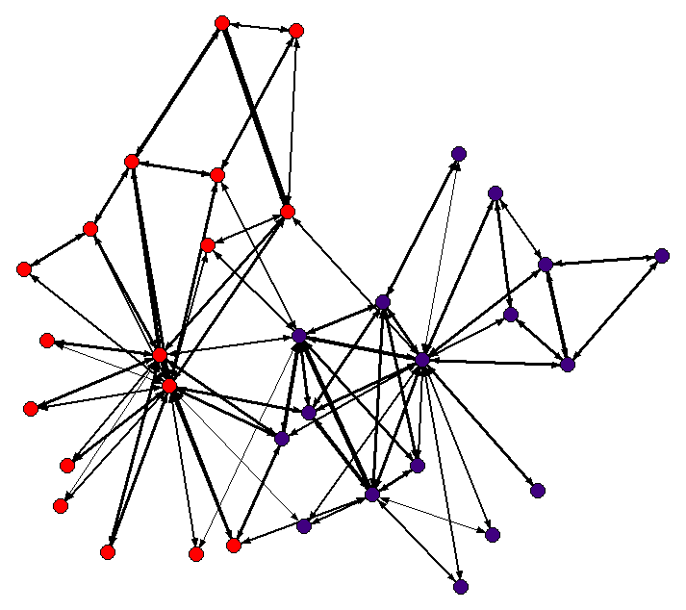
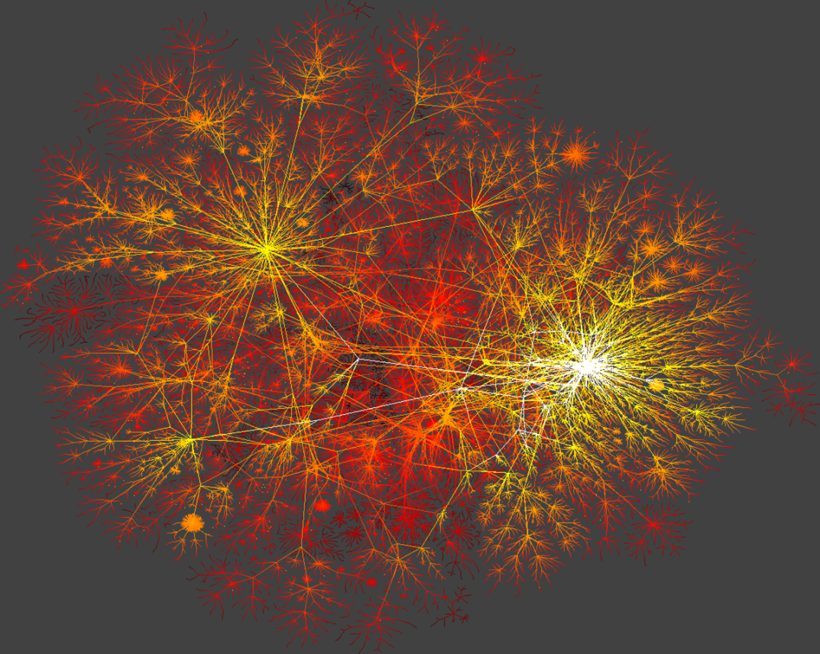
Social Network Analysis (SNA) and Network Science
Zachary Karate Club (Zachary, 1977)
34 members of a Karate club
2 subgroups of members predicted by communications outside of the club
Internet Connectivity
(By K. C. Claffy, www.caida.org)

Slide 3
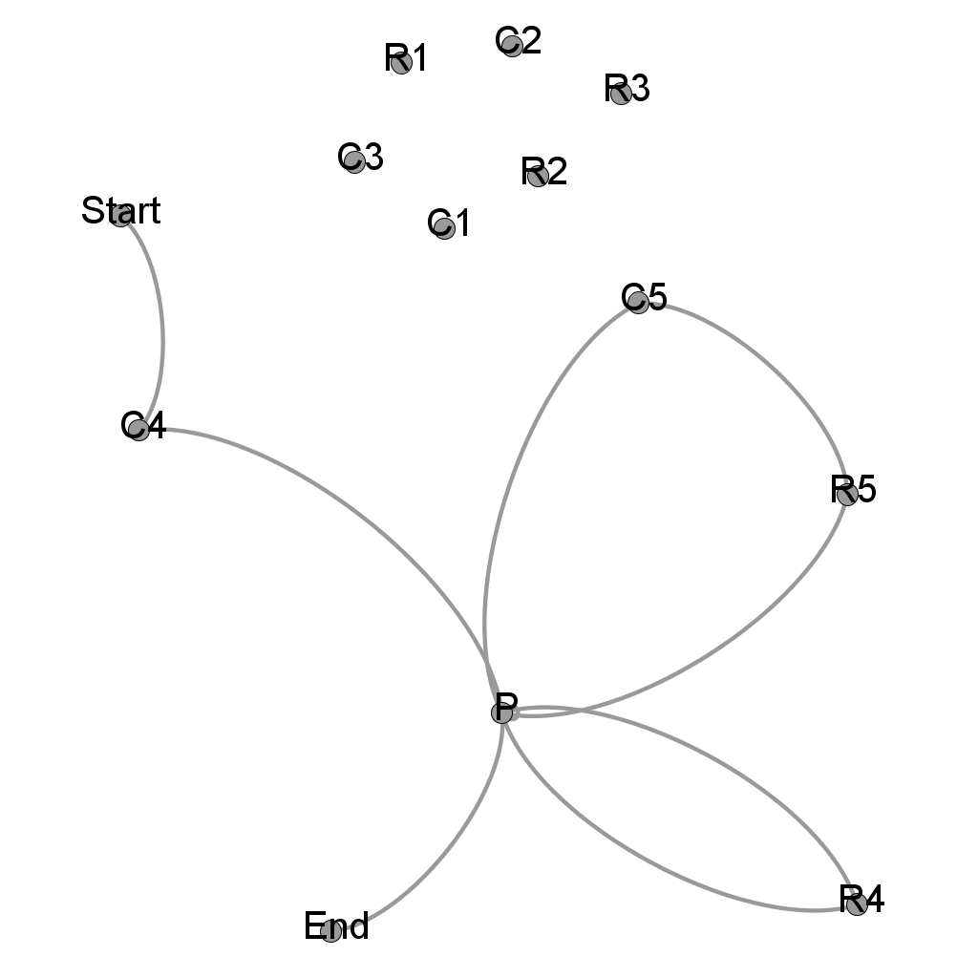
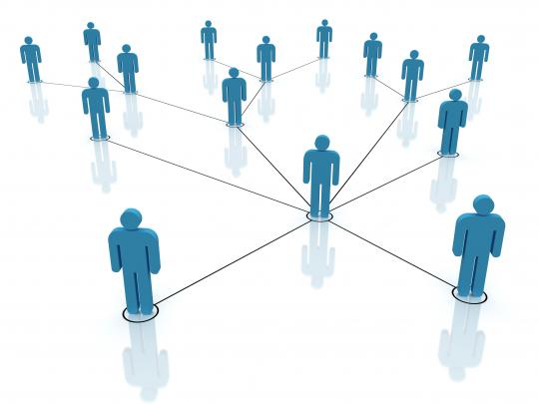
SNA in Education
Networks of Students and/or Teachers
Networks for Learning and Problem Solving

Slide 4
Motivation
Understanding student cognitive processes during assessments
How do students solve problems differently?
How do response processes vary as a function of students’ mastery of related knowledge?
How can SNA be useful in understanding learning and problem solving?

Slide 5
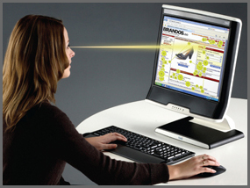
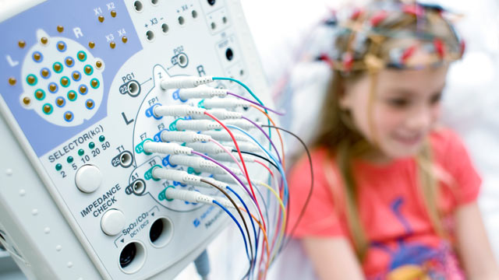
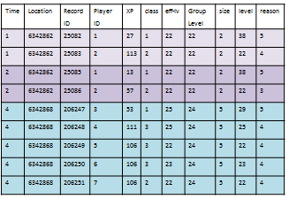
Capture Cognitive Processes
Eye Tracking | EEG | Log Data

Slide 6
Three Studies using Network to Model and Analyze Educational Data
Study 1: Modeling eye tracking data from math assessment
Study 2: Modeling process data from log records
Study 3: Modeling student discourse data in assessment of Engineering Professional Skills (EPSs)

Slide 7
Study 1: Modeling eye tracking data from math assessment

Slide 8
Related Eye-tracking Studies
Eye gaze is a proxy of the attention “spotlight” (Findlay & Walker, 1999; Posner, 1980)
Relevant eye movements studies
Similar eye-gaze patterns among participants with similar science backgrounds while solving multiple-choice problems (Tai et al., 2012)
Students with correct answers looking at relevant areas more (Bayazit et al., 2014; Madsen et al., 2012)
This study focuses on transitions of students’ attention between Areas of Interests (AOIs)
Notes:
-eye-gaze patterns are similar among participants with similar science backgrounds and different across different disciplines.
-Successful students tend to look at relevant areas.

Slide 9
An Eye Tracking Study to Model Eye Movements in Math Problem Solving*
Participants
37 eighth-grade students
Eye-tracking
Tobii T120
60 samples per second
Conducted at school and lab
* Zhu, M., & Feng, G. (2015). An exploratory study using social network analysis to model eye movements in mathematics problem solving. In Proceedings of the 5th International Learning Analytics and Knowledge Conference (LAK ’15) (pp. 383–387). Poughkeepsie, NY: ACM.

Slide 10
The Moving Sidewalks One-Rider Task
Part of the CBAL initiative (Cognitively Based Assessment of, for, and as Learning; Bennett, 2010)
A scenario-based mathematics assessment of students’ understanding of linear functions (Graf et al., 2010)

Slide 11
Functions & Linear Functions Learning Progression

Slide 12
Eye Tracking Scan Path
Time

Slide 13
Areas of Interest (AOIs)
IMAGE
Q_A
Q_A_Response
Q_B
GRAPH
Q_B_Response
Q_C
Q_C_Response1
Q_C_Response2
Q_D
Q_D_Response

Slide 14
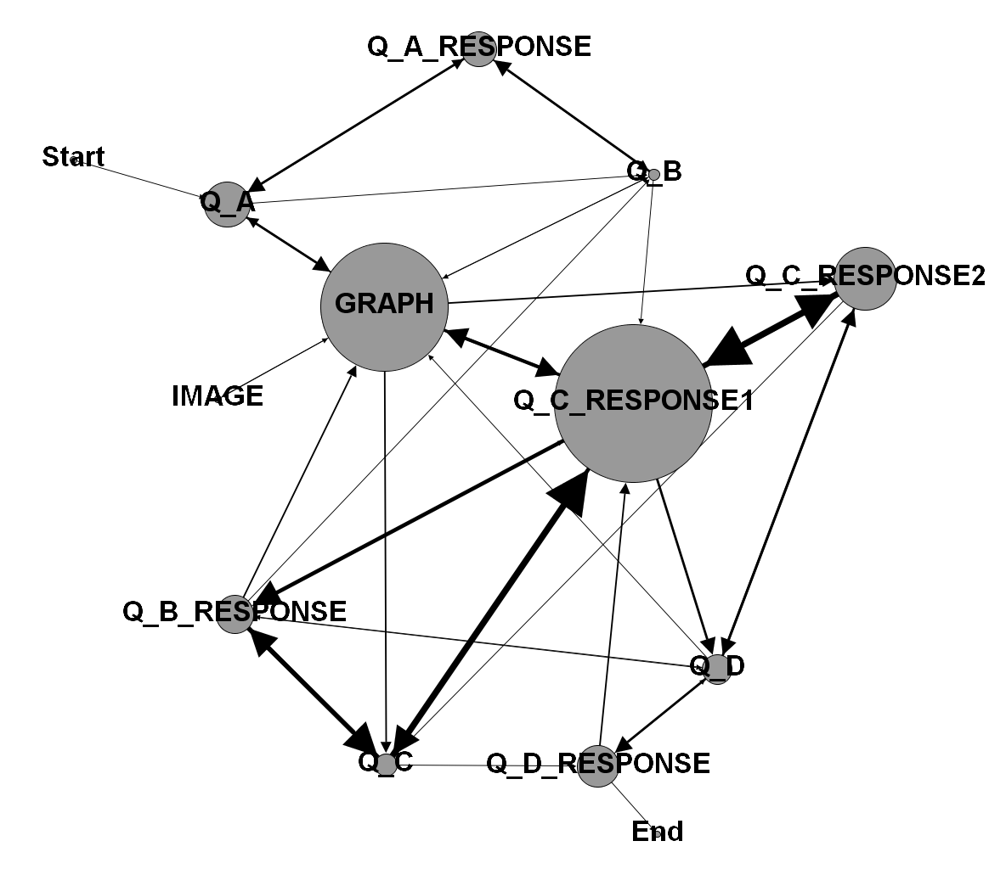
A Sample AOI Transition Network
Node size represents time spent on the AOI
Link thickness represents frequencies of transitions

Slide 15
Network Measures for the Transition Networks
Introducing measures from Social Network Analysis
Density
Reciprocity
Triad Census (Davis & Leinhardt, 1972)

Slide 16
Network Statistics for Transition Networks
 | Mean | SD | Min | Max
Density | 1.38 | 0.79 | 0.03 | 4.03
Reciprocity | 0.61 | 0.11 | 0.35 | 0.81
003 | 58.32 | 42.02 | 22 | 246
012 | 44.08 | 13.49 | 20 | 69
102 | 62.89 | 14.81 | 9 | 98
021D | 2.95 | 1.87 | 0 | 8
021U | 2.51 | 2.02 | 0 | 9
021C | 6.19 | 3.91 | 0 | 16
111D | 17.73 | 5.59 | 1 | 29
111U | 17.84 | 5.70 | 1 | 26
030T | 1.35 | 1.34 | 0 | 5
030C | 0.78 | 1.00 | 0 | 4
201 | 17.84 | 8.35 | 0 | 37
120D | 2.60 | 2.23 | 0 | 8
120U | 2.95 | 2.22 | 0 | 9
120C | 7.24 | 4.91 | 0 | 20
300 | 21.16 | 10.62 | 0 | 40
On average, at least one transition between any two AOIs
Students tend to revisit AOIs

Slide 17
Network Statistics for Transition Networks
 | Mean | SD | Min | Max
Density | 1.38 | 0.79 | 0.03 | 4.03
Reciprocity | 0.61 | 0.11 | 0.35 | 0.81
003 | 58.32 | 42.02 | 22 | 246
012 | 44.08 | 13.49 | 20 | 69
102 | 62.89 | 14.81 | 9 | 98
021D | 2.95 | 1.87 | 0 | 8
021U | 2.51 | 2.02 | 0 | 9
021C | 6.19 | 3.91 | 0 | 16
111D | 17.73 | 5.59 | 1 | 29
111U | 17.84 | 5.70 | 1 | 26
030T | 1.35 | 1.34 | 0 | 5
030C | 0.78 | 1.00 | 0 | 4
201 | 17.84 | 8.35 | 0 | 37
120D | 2.60 | 2.23 | 0 | 8
120U | 2.95 | 2.22 | 0 | 9
120C | 7.24 | 4.91 | 0 | 20
300 | 21.16 | 10.62 | 0 | 40
Most observed structures indicating lack of transitions among 3 AOIs
Least observed structure indicating chain of sequential visits not popular in this dataset

Slide 18
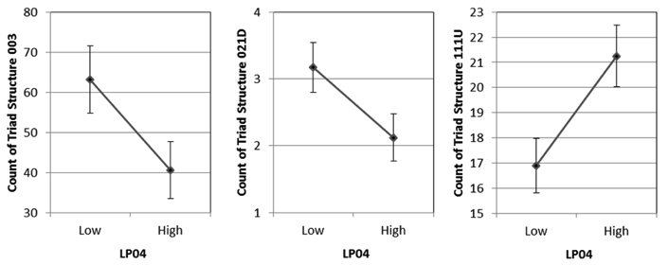
Eye Movement Patterns and Student Knowledge Levels
High performing students are more strategic than low performing students.

Slide 19
Study 2: Modeling process data from log records

Slide 20
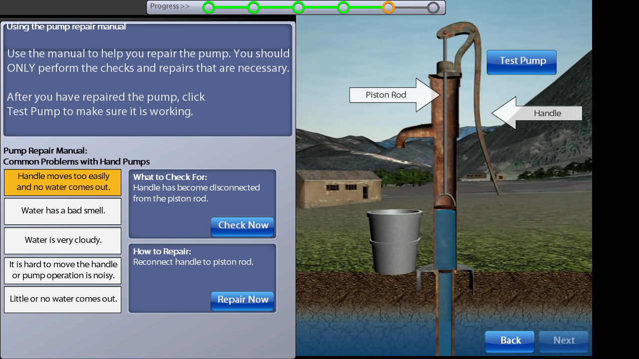
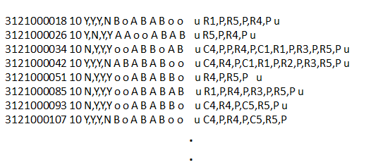
Analyzing Process Data from Scenario-based Assessment*
Wells, an Example from NAEP Technology and Engineering Literacy (TEL)
http://nces.ed.gov/nationsreportcard/tel/
Solving a problem through interactions
1,318 student samples from NAEP pilot study
P
C1, C2, C3, C4, C5
R1, R2, R3, R4, R5
* Zhu, M., Shu, Z., & von Davier, A. A. (2016). Using networks to visualize and analyze process data for educational assessment. Journal of Educational Measurement, 53(2), 190–211.
Log data
Notes:
NAEP - National Assessment of Educational Progress (NAEP) project for National Center for Education Statistics
TEL - Technology and Engineering Literacy (TEL) assessment
http://nces.ed.gov/nationsreportcard/tel/
Mission of Wells
To fix a Well that could not pump water out
5 problems that could cause the problem
Problems 4 and 5 are the reasons
Through 11 options
5 Checking Options, to find out if the selected part of the well is malfunction: C1, C2, C3, C4, C5
5 Repairing Options, to fix the parts that may cause the Well’s malfunction: R1, R2, R3, R4, R5
1 Pumping Options, to run the well if pumping water out: P

Slide 21
From Action Sequence to Action Transition Network
N=1
Data:
C4,P,P,R4,P,C5,R5,P
Gephi
https://gephi.org/ Open-source and Free Software

Slide 22
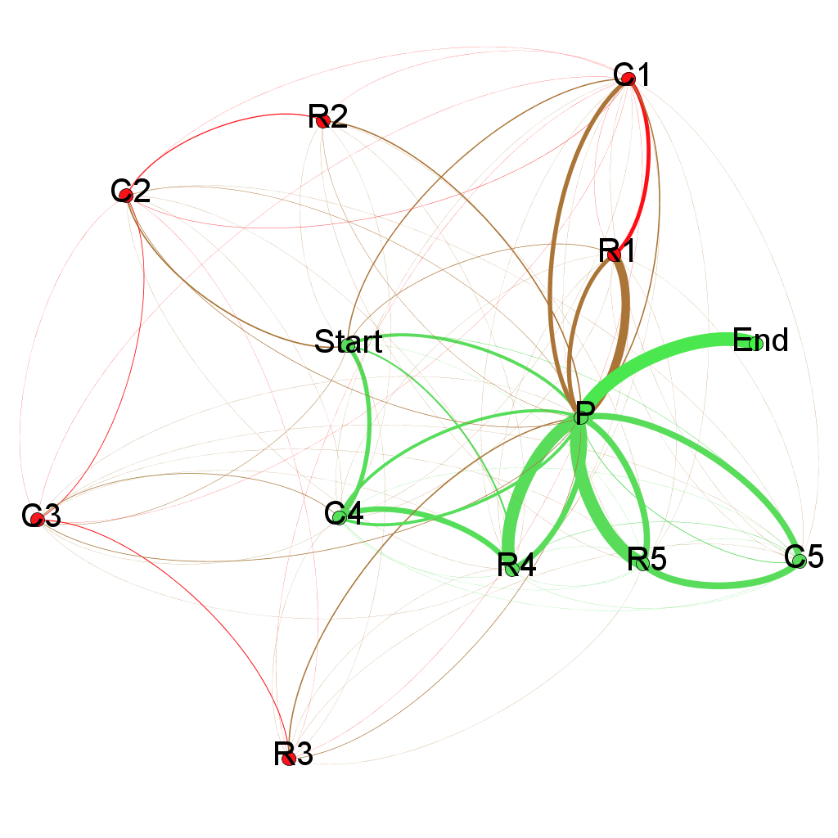
Transition Network of All Students
Data:
C1,P,C2,R3,R1,P,C4,R4,P,R5,P
C1,P,P,R3,P,R5,P,R4,P
C1,P,R1,P,C3,R3,R4,R5,P
C1,P,R2,R4,P,R5,P
C1,P,R4,P,R1,P,P,C4,P,R3,P,R5,P
C1,P,R4,P,R1,P,R5,P
...
Some Observations:
All sequences end with “P”
From “start”, “C4” has the highest frequency
More C1/R1 visits than C2/R2/C3/R3
N=1,318

Slide 23
Observations Related to Item Design and Layout
Observation: More C1/R1 visits than C2/R2/C3/R3
Potential Explanation: Option for Part 1 appears first
Observation: From “start”, “C4” has the highest frequency
Potential Explanation: Option for Part 4 is on top of option for Part 5

Slide 24
Scoring: Process Efficiency and Systematicity
Efficiency
The student should perform troubleshooting & repair actions in an efficient manner
Ranges from1 to 5
Systematicity
The student should perform troubleshooting & repair actions in a methodical, systematic fashion
Ranges from 1 to 3

Slide 25
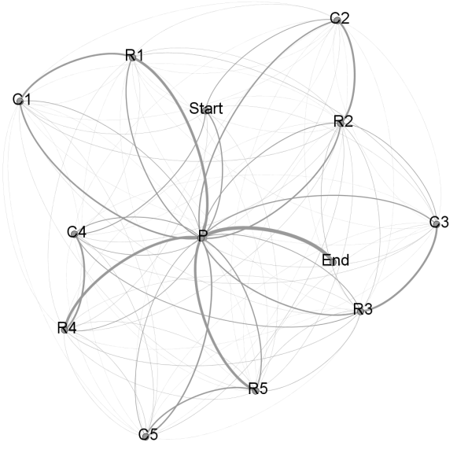
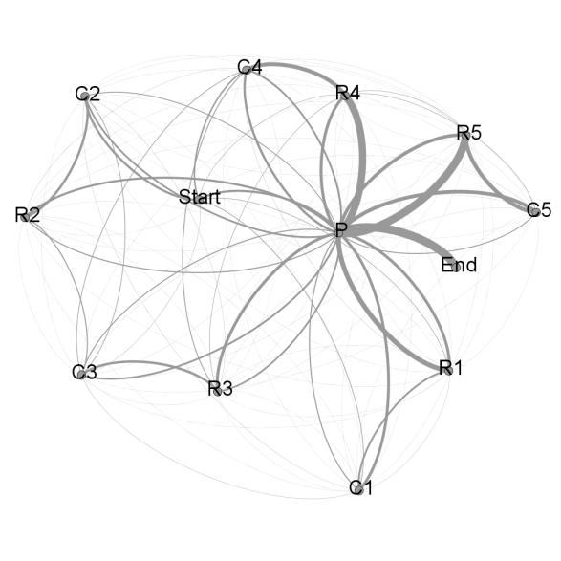
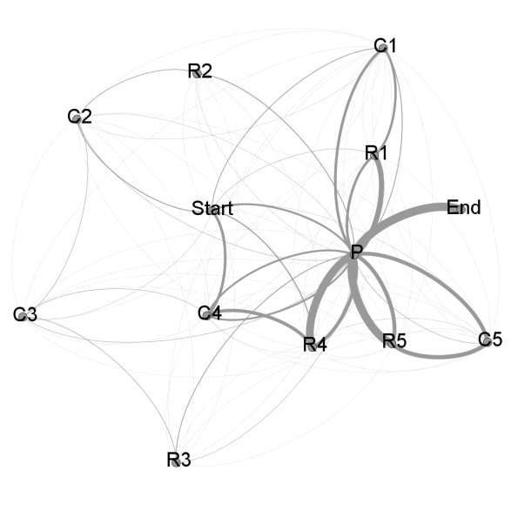
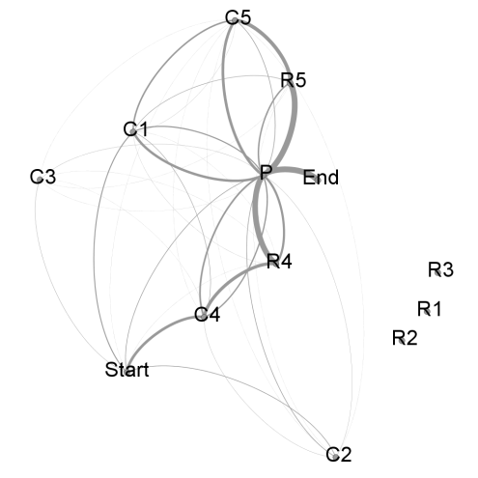
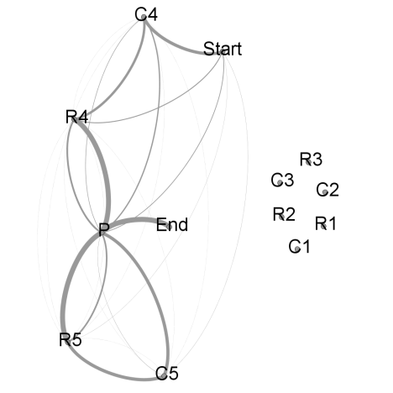
Scoring: Process Efficiency
Efficiency = 1
Efficiency = 2
Efficiency = 3
N=67
N=123
N=311
Efficiency = 4
Efficiency = 5
N=76
N=741

Slide 26
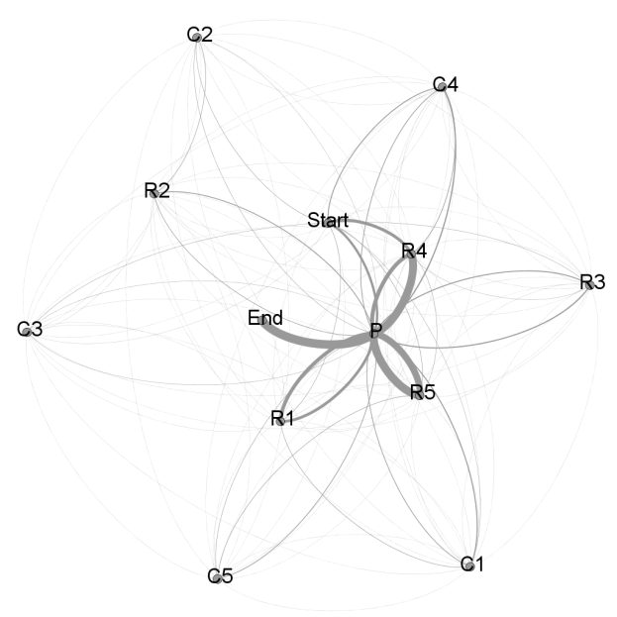
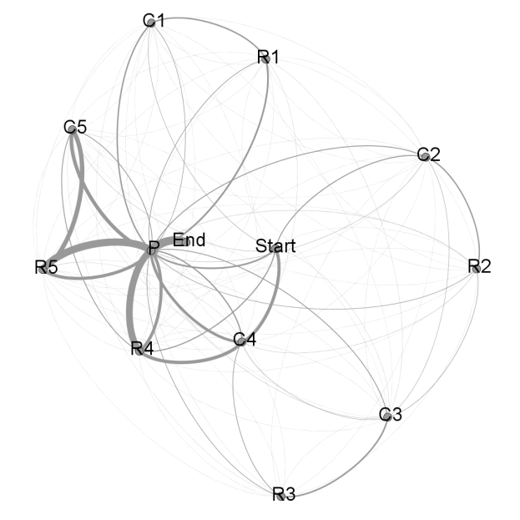
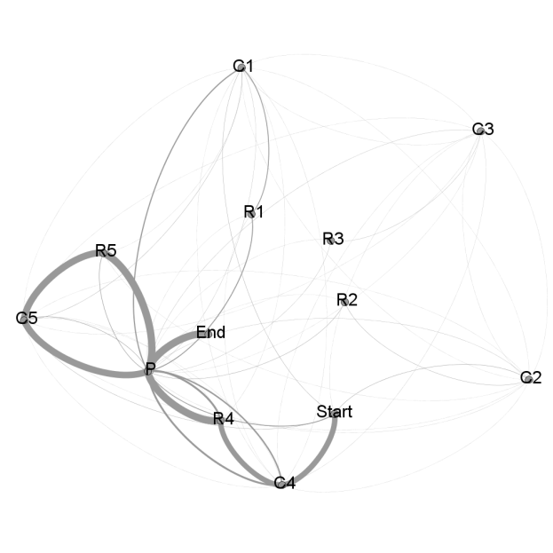
Scoring: Process Systematicity
Systematicity = 1
Systematicity = 2
Systematicity = 3
N=406
N=296
N=621

Slide 27
One More Network Measure - Centralization
Centralization
Density
Reciprocity
Triad Census (Davis & Leinhardt, 1972)

Slide 28
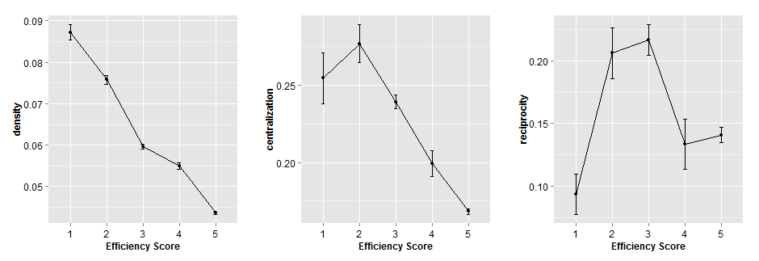
Comparison of Network Statistics for Different Efficiency Score Categories
Density captures what the efficiency score measures and might be a good indicator of students’ efficiency scores
Centralization are related to efficiency but may not be good linear predictor
Reciprocity is low in both low ends and high for students with medium efficiency scores

Slide 29
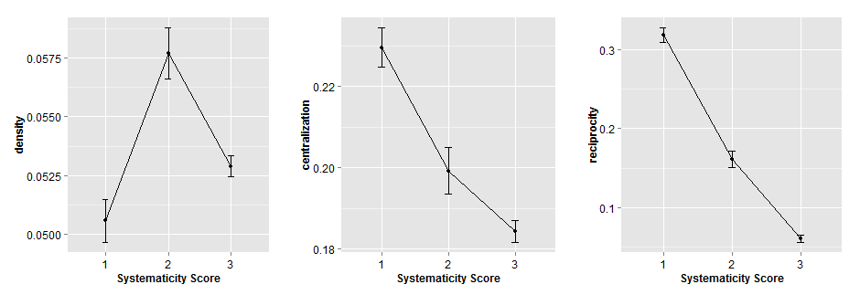
Comparison of Network Statistics for Different Systematicity Score Categories
Density is no longer a good indicator of students’ systematicity scores
Centralization and reciprocity might be good indicators for systematicity

Slide 30
Prediction Power of Network Statistics
A step-wise discriminant analysis (Klecka, 1980) with student efficiency score as dependent variable and all network statistics as independent variables
The overall Chi-square test was significant (Wilks λ = .16, Chi-square = 2428.62, df = 32, p <. 001)
The four functions extracted accounted for nearly 84% of between group variability
Reclassification of cases based on the new canonical variables correctly classified 78.5% of the cases
For systematicity scores
The overall Chi-square test was significant (Wilks λ = .46, Chi-square = 1021.96, df = 12, p <. 001)
the two functions extracted accounted for nearly 54% of between group variability
Reclassification of cases based on the new canonical variables correctly classified 71.5% of the cases

Slide 31
Study 3: Modeling student discourse data in assessment of Engineering Professional Skills (EPSs)

Slide 32
Engineering Professional Skills (EPSs)
The 21st century working environment calls for the “professional skills” that enable graduating engineering students to work effectively and collaboratively with others in any problem solving situation (American Association of Colleges and Universities, 2013; American Society for Engineering Education & National Science, 2013; Seat et al., 2001; Sheppard et al., 2008)
Engineering professional skills (EPSs) (ABET, 2011) include
Making ethical judgment and integrity
Teamwork and communication
Applying technical knowledge in real-world scenarios
Having the ability of continued learning
Considering contemporary issues, methods and technology

Slide 33
Assessing engineering professional skills (EPSs)*
Engineering Professional Skills Assessment (EPSA)
Scenario-based performance assessment
Conceptualized to be a direct measure of five skills identified in the Student Outcome ABET Criterion 3 (Ater Kranov et al., 2011, 2013; Ater Kranov et al., 2008)
Each EPSA assessment consists of
A scenario of a modern engineering problem with no clear solution
An analytical scoring rubric
Unit of analysis
A group of 4-6 students, who is instructed to engage in a 45-minute discussion around the issue presented in the scenario
Standard scores for EPSA
Experienced engineering faculties and researchers rate each transcript from a discussion session; One score for each of the five EPS dimensions
* Zhu, M., & Zhang, M. (2017). Network analysis of conversation data for engineering professional skills assessment. ETS Research Report RR-17-59.

Slide 34
Assessing EPSs and SNA
Can SNA help us to capture more information beyond scores on EPS dimensions?
Focus on the process of the group discussion
Understand the communication patterns among the students, and the connections among the EPSs evidenced through the discussion process
Method
SNA on two types of networks
Communication Network – Who was talking to whom, and how frequent the communication is during the discussion process
EPS Network – which skills co-appeared in the same utterance, and how frequent the co-appearances are during the discussion process
Temporal studies
Divide the transcripts to three sessions, T1, T2, T3, which cover the beginning, the middle and the end of the discussion

Slide 35
Research Samples
Two student-groups from two engineering colleges in the United States
One group has 4 students and the other has 5 students
Senior undergraduate students majored in Electric Engineering and Computer Science
The scenario is about the nuclear disaster in Fukushima in 2011
Discussions were audio-recorded and professionally transcribed
Each transcript/group performance was evaluated by at least two graders using the EPS analytical scoring rubric
Each transcript was also coded by at least two coders
High group and Low group using scores on skills
 | Skill Set
 | 3f | 3g | 3h | 3i | 3j
High-Performing Group | 4.0 | 3.8 | 3.6 | 2.0 | 3.4
Low-Performing Group | 1.4 | 1.2 | 1.0 | 1.0 | 1.0

Slide 36
Coding and construction of the communication networks
Student A: Where do we start?
Student B: Kind of where we start. And the best way to start is to list out the facts, and I would have to state that -- or we have already stated that 20 kilometers zone is how they quarantined off the area, and then --
Student C: For people.
Student B: For people. And then --
Student C: And even more for food stock.
A
All
B
C

Slide 37
Coding and construction of the EPS co-occurrence networks
Example 1
Student: We couldn’t -- their big problem is that they couldn’t -- there wasn’t any cooling or ventilation, which was something they should have foreseen or had.
Example 2
Student: That’s true. But it could be -- it could go to the extent that there could be even like international organizations contributing to this just because of how severe the situation is. So we could go ahead with the assumption that we have a huge pool of money to pull from.
ProblemID (3f)
Impact (3h)
NonTech
Issue (3j)

Slide 38
Communication networks for high group and low group
High Group (T1)
High Group (T2)
High Group (T3)
High Group (Overall)
Low Group (T1)
Low Group (T2)
Low Group (T3)
Low Group (Overall)
High Group had denser communication networks than the Low Group.
The communication in the Low Group was dominated by a subset of students.
None of the students in the Low Group spoke to the whole group (All) during T2 and T3.

Slide 39
Network statistics on communication networks
 | Size | Weighted Density | Max Indegree | Max Outdegree | Centralization (Indegree) | Centralization (Outdegree) | Reciprocity | Transitivity
High Group (T1) | 6 | 3.63 | 5.00 | 4.00 | 0.52 | 0.28 | 0.55 | 1.00
High Group (T2) | 6 | 3.63 | 4.00 | 4.00 | 0.32 | 0.32 | 0.60 | 1.00
High Group (T3) | 6 | 3.57 | 5.00 | 4.00 | 0.56 | 0.32 | 0.45 | 0.94
High Group (Overall) | 6 | 10.83 | 5.00 | 4.00 | 0.52 | 0.28 | 0.55 | 1.00
Low Group (T1) | 7 | 0.95 | 3.00 | 4.00 | 0.28 | 0.47 | 0.22 | 0.43
Low Group (T2) | 7 | 0.93 | 2.00 | 2.00 | 0.28 | 0.28 | 1.00 | 0.00
Low Group (T3) | 7 | 0.93 | 3.00 | 3.00 | 0.36 | 0.36 | 0.60 | 0.38
Low Group (Overall) | 7 | 2.81 | 4.00 | 5.00 | 0.33 | 0.53 | 0.33 | 0.55
High Group had denser communication networks than the Low Group.
The communication in the Low Group was dominated by a subset of students.
None of the students in the Low Group spoke to the whole group (All) during T2 and T3.

Slide 40
Engineering professional skills networks for high group and low group
High Group (T1)
High Group (T2)
High Group (T3)
High Group (Overall)
Low Group (T1)
Low Group (T2)
Low Group (T3)
Low Group (Overall)
High Group had denser connections among EPSs than the Low Group.
High Group had almost all skills present and related to other skill(s) over the course of the discussion.
The Low Group had connection among only a subset of the EPSs.

Slide 41
Network statistics on the EPS networks
 | Weighted Density | Max Degree | Centralization
High Group (T1) | 2.69 | 102.00 | 0.30
High Group (T2) | 3.17 | 98.00 | 0.30
High Group (T3) | 0.72 | 26.00 | 0.50
High Group (Overall) | 6.58 | 220.00 | 0.13
Low Group (T1) | 0.69 | 42.00 | 0.30
Low Group (T2) | 0.92 | 28.00 | 0.34
Low Group (T3) | 0.11 | 8.00 | 0.50
Low Group (Overall) | 1.72 | 64.00 | 0.43
Students in both groups tend to execute less of EPSs towards the end of a discussion session
High Group had denser connections among EPSs than the Low Group.
High Group had almost all skills present and related to other skill(s) over the course of the discussion.
The Low Group had connection among only a subset of the EPSs.

Slide 42
Takeaways from the Three Discussed Studies
Think Networks!
The applications of SNA go beyond modeling the connections among humans
Network analysis can help us understand the decision making and problem solving processes of students, as well as the interconnections of students’ skills
High-performing and low-performing students/teams showed different relational patterns in the modeled networks
To-dos in the near future
More network analysis measures and more advanced network models (e.g., ERGMs)
Cluster analysis of networks
Focus on the content of nodes in the networks

Slide 43
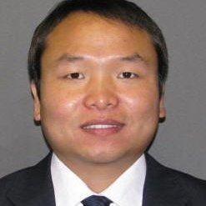
Acknowledgement
Gary Feng
Zhan Shu
Alina von Davier
Mo Zhang

Slide 44
Network Analysis for Learning Analytics
Mengxiao Zhu
Educational Testing Service
mzhu@ets.org

