Slide 1
Virtual YMHFA Training For Asian American Parents and Adults: Effectiveness And Promise
Diksha Bali, M.Ed.
Mazneen Havewala, M.A.
Cixin Wang, Ph.D.
Kristen Marsico-Friese, Ph.D.
University of Maryland, College Park

Slide 2
Introductions
Who we are
Who you are!
Current role/profession & state
Interest in this session
Experiences with ERM youth/challenges

Slide 3
Overview
What is YMHFA? How could it be beneficial for ERM youth?
Rationale for offering YMHFA virtually
Intended contribution to the literature/field
Study methods
Results
Discussion

Slide 4
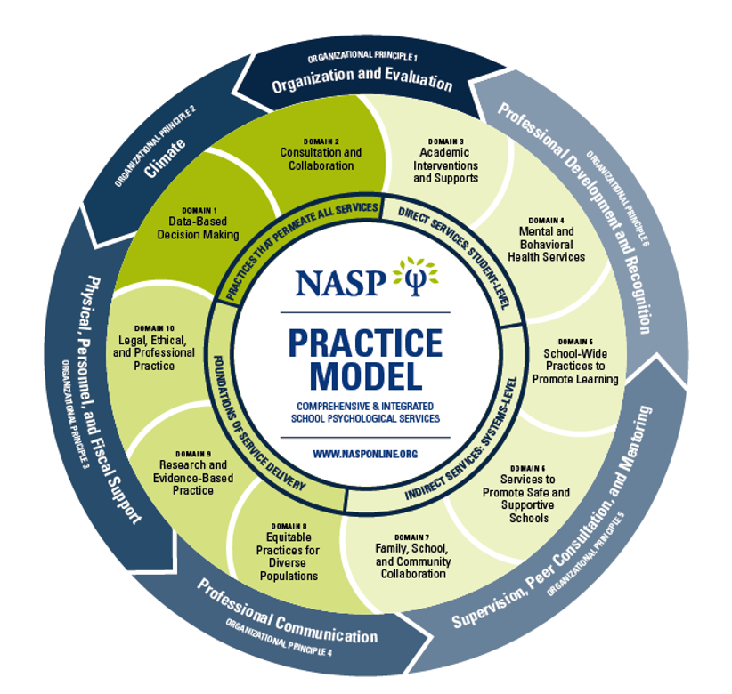
Relevance to NASP Practice Model
Domain 7: Family–School Collaboration Services
Domain 8: Equitable Practices for Diverse Populations

Slide 5
What is YMHFA? Why is it beneficial, especially for AA and ethnic minority youth?

Slide 6
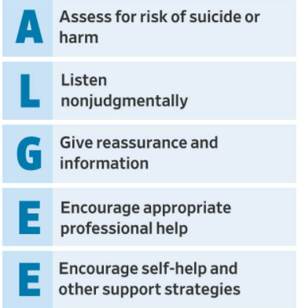
Youth Mental Health First Aid Training
Manualized, adapted from Australian version
Teaches warning signs and protective factors for mental health issues
Addresses need for helper self care
8h in person, 2 + 5.5h online
ALGEE 5-step model for basic intervention

Slide 7
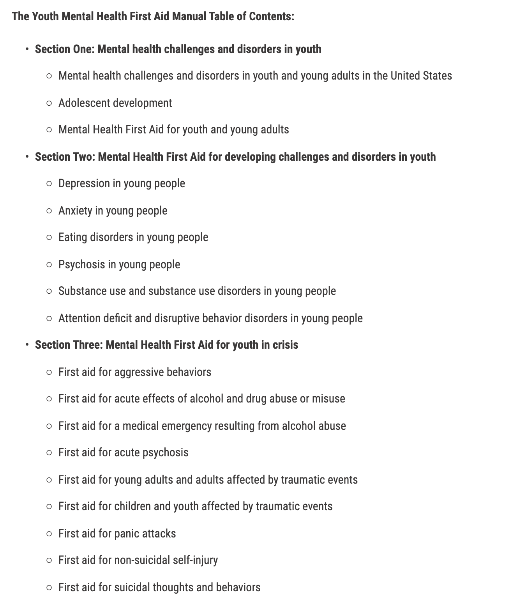
General Content Overview (Excerpted from the in-person session manual)

Slide 8
YMHFA effectiveness
Effectiveness (Aakre et al., 2016; Gryglewicz et al., 2019)
Improved mental health literacy
Increased confidence in being able to identify and respond to youth problems
Increased intentions to offer assistance to youth
Decreased negative attitudes towards mental illnesses
Samples not very ethnically/racially diverse, no tailored curricula

Slide 9
YMHFA in Context of Ethnic Minority Youth and Families
Stigma related to mental health services (historical factors? bias?...avoid pathologizing ERM communities)
Ethnic minority youth access fewer services (APA, 2017)
YMHFA, if tailored, could support resilience, healing, and more open conversations about mental health issues in ERM communities

Slide 10
YMHFA in context of COVID-19 & specifically for AA youth
COVID-19 pandemic: highly stressful time, especially for Asian Americans
Stress: virus, but also acts of discrimination
Hate incidents increased 2-fold from 3,795 in March 2020 to 6,603 in March 2021 (Jeung et al., 2021)
54.3% of Asian American parents and 58.0% Asian American youth experienced daily or weekly direct racism → youth internalizing symptoms (Cheah et al., 2020)
Notes:
Mazneen

Slide 11
YMHFA in the Context of COVID-19 & Specifically for AA Youth
Need for Asian Americans to receive mental health support
Vulnerable population
Suicide leading cause of death in 15-24 (2016 data; Heron, 2018)
Asian American youth less likely to receive help
Barriers to seeking help
Notes:
Mazneen

Slide 12
What are some barriers to seeking help for ERM youth?
Notes:
Diksha

Slide 13
Possible Barriers for AA youth
Stigma (internal, external...distrust of services)
Lack of parental support for seeking services
(Internalized) model minority stereotype
Mental health literacy/awareness
Reluctance to seek help
Low cultural competence among mental health providers
Lack of multilingual services
Cost
Notes:
Diksha

Slide 14
Need for: Culturally Sensitive, Accessible Interventions
Culturally adapted interventions more effective (Smith & Trimble, 2016)
One such way: via parenting workshops
Found to be less stigmatizing (Wang et al., 2021)
YMHFA can be adapted as one such intervention for AA parents
Can create room to focus on protective factors/assets as well in interventions
Notes:
Diksha

Slide 15
Accessibility: Virtual Interventions
Implement core values of School Psychology
Reach underserved populations
Advance social justice
Training for greater cultural understanding
E.g., Anxiety and Depression - difficult to come in
E.g., Areas that are more remote/removed from cities and services
E.g., COVID-19 and physical health considerations
Notes:
Diksha

Slide 16
Effectiveness of Virtual Interventions

Slide 17
Virtual Interventions
In 2020, virtual version of YMHFA rolled out
Participants were required to complete a 2-hour self-paced online course, and then participate in a 4.5 to 5.5 hour instructor led virtual session
No published studies
Notes:
Mazneen

Slide 18
Evidence Base for Virtual Parent/Youth Services
Reigler and colleagues (2020):
Developed a tele psychotherapy parenting skills program for veteran and military families
Parents completed six sessions, which consisted of web-based education and virtual consultations with licensed therapists.
The findings indicated that the program may be associated with improvements in veteran mental health and family functioning.
Notes:
Mazneen

Slide 19
Evidence Base for Virtual Parent/Youth Services
Garcia et al (2021)
Effectiveness of the Parent–Child Interaction Therapy (PCIT) in a virtual format in a predominantly Hispanic sample.
The researchers found that there was a reduction of maladaptive child behaviors, and an increase in positive parenting skills.
Notes:
Mazneen

Slide 20
Intended Intervention & Study Contributions
Notes:
Mazneen

Slide 21
Gaps in the Literature
No published studies on YMHFA virtual version
Most studies on YMHFA USA on social workers, school teachers, child welfare workers and county workers – no published work on parents
Dearth of research examining effects of YMHFA on ERM parents & Asian American parents
Unique stressors experienced by this population
No published studies on virtual YMHFA
Notes:
Mazneen

Slide 22
Current Study
Aim to address the gaps
Specifically targeted Asian Americans
Utilized a pre-post study design to examine effectiveness of YMHFA in relation to:
Mental health literacy
Confidence in using MHFA skills
Help seeking attitudes
Help seeking intentions
Stigma
Notes:
Mazneen

Slide 23
Method

Slide 24
Procedure: Recruitment
Study approved by UMD IRB
Two cohorts of participants recruited in May and August of 2021
Recruitment took place via distribution of flyer on social media and community organizations
Interested participants provided consent, complete the pre-training survey a week before the training (via Qualtrics)
Complete post-survey one week after training (via Qualtrics)
Notes:
Mazneen

Slide 25
Procedure: Content
Manualized curriculum (adapted)
Workshop trainers:
licensed PhD-level School Psychologist (East Asian American) and doctoral SP student mentee (South Asian American) co-led workshops
Notes:
Mazneen

Slide 26
Procedure: Community-Informed Adaptations
Adaptations:
Guided by the Participatory Culture-Specific Consultation (Nastasi et al., 2000)
Collaborated with multiple Asian American community organizations to understand AA parent needs in the past five years (see Wang et al., 2021a; Wang et al., 2021b)
E.g., Chinese Culture and Community Service Center (CCACC) and Indian Cultural Association leaders
Developed "Parent-Teen Connect" parent and child workshops
Notes:
Mazneen

Slide 27
Procedure: Community-Informed Adaptations
Interviewed East Asian parents and youth during COVID-19 about experiences with racism
Essay contests for youth (East & South Asian American)
Example: Essay Contests through CCACC (2018) and Indian Cultural Association (2020)
Themes:
Parent-child communication issues
Academic pressures
Pressures to excel
Lack of emphasis on mental health
Focus groups after previous YMHFA training for East Asian Americans
Notes:
Mazneen

Slide 28
Procedure: YMHFA Adaptations
Based on what we learned, we incorporated discussion in YMHFA around:
Stressors and challenges unique to Asian American parents and youth (stigma, minority stress)
Parenting struggles for Asian Americans
talk about culturally specific parenting practices, e.g., cultural emphasis of academic excellence, humility (instead of praise), and emotional restraint
the “model minority myth” and academic pressure related to youth mental health and suicide.
Notes:
Mazneen

Slide 29
Adaptations: Discussion Questions
"What are some unique risk and protective factors for AA youth mental health?"
"How does Asian culture impact your ability to use ALGEE steps?"
"Are you able to relate to the content introduced? How does your being an Asian American come into play here?"
"In what ways do the concepts introduced in the YMHFA self-paced introduction connect to your struggles of parenting, especially you belonging to the Asian American community?"
Notes:
Mazneen

Slide 30
Participants
49 participated in the training
38 completed the surveys
n=36
60 participants signed up
60 participants initially signed up
49 participated in the training (2 cohorts)
38 completed both pre- and post-training measures (22 in May; 16 in August).
Only the 36 Asian American participants were included in analyses
Notes:
Mazneen

Slide 31
Study Sample Characteristics (n=36)
Age | Sex | Immigration Status | Ethnicity | Education | Parent?
25 to 60 (Mage = 47, SDage = 8.86) | 86.1% Female (n=31) | 91.7% Foreign-Born (n=33) | 88.9% Chinese-born (n=32) | 83.3% with MS degree (n=29). All had at least BA/BS | 83.3% were Parents (n=30)
Notes:
Mazneen

Slide 32
Measures
Mental Health Literacy Scale (O’Conner & Casey, 2015)
Youth Mental Health Opinions Quiz (National Council of Mental Wellbeing)
Confidence in MHFA skills (Haggerty et al., 2018)
Parental Attitudes Towards Psychological Services Inventory (PATPSI; Turner, 2012)
Satisfaction Scale (Fabrizio et al., 2013)
Notes:
Mazneen
MHLS: ). Respondents are asked to respond to a variety of questions on Likert-scales, including anchors ranging from “very unlikely” to “very likely” (1-4), “very unhelpful to very helpful” (1-4), “strongly disagree” to “strongly agree” (1-5), and “definitely unwilling” to “definitely willing” (1-5).
If I believe my child were having a mental breakdown, my first decision would be to get professional help” (help-seeking intention), “I would not want to take my child to a professional because of what people might think” (stigmatization), and “Strong willed parents can handle problems without professional help” (help-seeking attitudes).
I feel confident in my ability to ask school-aged youth questions that determine whether they are at risk to physically harm themselves or others.”

Slide 33
Analysis & Results

Slide 34
Analysis Approach
Pre-post, paired independent t-tests in SPSS
Pairwise deletion for missing data.
Little’s MCAR test --> data were missing completely at random (p = .363).
No covariates were included.
Only help seeking intention pre-training significantly differed by education level
Master’s level more likely to seek help than Bachelor’s level individuals.
Combined our cohorts and ran analyses on the combined dataset (no differences between cohorts on outcome vars)
Notes:
Diksha

Slide 35
Results: Knowledge & Intentions
Table 1. Independent samples paired t-test results from analyses conducted to assess pre- and post- differences in our measures of interest.
 | n | Pretest Mean(SD) | Posttest Mean(SD) | df | t- statistic | Cohen’s d
Mental Health Literacy Scale*** (1 to 5) | 36 | 3.44(.37) | 3.79(.37) | 35 | 6.53*** | 1.09
Note. *** indicates p < .001 ** indicates p < .01 * indicates p < .05
Notes:
Diksha

Slide 36
Results: Knowledge & Intentions
Table 1. Independent samples paired t-test results from analyses conducted to assess pre- and post- differences in our measures of interest.
 | n | Pretest Mean(SD) | Posttest Mean(SD) | df | t- statistic | Cohen’s d
Mental Health Literacy Scale*** (1 to 5) | 36 | 3.44(.37) | 3.79(.37) | 35 | 6.53*** | 1.09
Confidence/Self-Efficacy Scale*** (1 to 5) | 36 | 3.24(1.00) | 4.14(.96) | 35 | 5.09*** | 1.07
Note. *** indicates p < .001 ** indicates p < .01 * indicates p < .05
Notes:
Diksha

Slide 37
Results: Knowledge & Intentions
Table 1. Independent samples paired t-test results from analyses conducted to assess pre- and post- differences in our measures of interest.
 | n | Pretest Mean(SD) | Posttest Mean(SD) | df | t- statistic | Cohen’s d
Mental Health Literacy Scale*** (1 to 5) | 36 | 3.44(.37) | 3.79(.37) | 35 | 6.53*** | 1.09
Confidence/Self-Efficacy Scale*** (1 to 5) | 36 | 3.24(1.00) | 4.14(.96) | 35 | 5.09*** | 1.07
PATPSI Help Seeking Attitude* (1 to 5) | 36 | 3.19(.55) | 3.39 (.53) | 35 | 2.63* | .439
Note. *** indicates p < .001 ** indicates p < .01 * indicates p < .05
Notes:
Diksha

Slide 38
Results: Knowledge & Intentions
Table 1. Independent samples paired t-test results from analyses conducted to assess pre- and post- differences in our measures of interest.
 | n | Pretest Mean(SD) | Posttest Mean(SD) | df | t- statistic | Cohen’s d
Mental Health Literacy Scale*** (1 to 5) | 36 | 3.44(.37) | 3.79(.37) | 35 | 6.53*** | 1.09
Confidence/Self-Efficacy Scale*** (1 to 5) | 36 | 3.24(1.00) | 4.14(.96) | 35 | 5.09*** | 1.07
PATPSI Help Seeking Attitude* (1 to 5) | 36 | 3.19(.55) | 3.39 (.53) | 35 | 2.63* | .439
PATPSI Help Seeking Intention*** (1 to 5) | 36 | 3.20(.46) | 3.51(.49) | 35 | 4.39*** | .731
Note. *** indicates p < .001 ** indicates p < .01 * indicates p < .05
Notes:
Diksha

Slide 39
Results: Knowledge & Intentions
Table 1. Independent samples paired t-test results from analyses conducted to assess pre- and post- differences in our measures of interest.
 | n | Pretest Mean(SD) | Posttest Mean(SD) | df | t- statistic | Cohen’s d
Mental Health Literacy Scale*** (1 to 5) | 36 | 3.44(.37) | 3.79(.37) | 35 | 6.53*** | 1.09
Confidence/Self-Efficacy Scale*** (1 to 5) | 36 | 3.24(1.00) | 4.14(.96) | 35 | 5.09*** | 1.07
PATPSI Help Seeking Attitude* (1 to 5) | 36 | 3.19(.55) | 3.39 (.53) | 35 | 2.63* | .439
PATPSI Help Seeking Intention*** (1 to 5) | 36 | 3.20(.46) | 3.51(.49) | 35 | 4.39*** | .731
PATPSI Stigmatization* (1 to 5) | 36 | 1.99(.64) | 1.82(.62) | 35 | 2.09* | .348
Note. *** indicates p < .001 ** indicates p < .01 * indicates p < .05
Notes:
Diksha

Slide 40
Results: Knowledge & Intentions
Table 1. Independent samples paired t-test results from analyses conducted to assess pre- and post- differences in our measures of interest.
 | n | Pretest Mean(SD) | Posttest Mean(SD) | df | t- statistic | Cohen’s d
Mental Health Literacy Scale*** (1 to 5) | 36 | 3.44(.37) | 3.79(.37) | 35 | 6.53*** | 1.09
Confidence/Self-Efficacy Scale*** (1 to 5) | 36 | 3.24(1.00) | 4.14(.96) | 35 | 5.09*** | 1.07
PATPSI Help Seeking Attitude* (1 to 5) | 36 | 3.19(.55) | 3.39 (.53) | 35 | 2.63* | .439
PATPSI Help Seeking Intention*** (1 to 5) | 36 | 3.20(.46) | 3.51(.49) | 35 | 4.39*** | .731
PATPSI Stigmatization* (1 to 5) | 36 | 1.99(.64) | 1.82(.62) | 35 | 2.09* | .348
Mental Health Knowledge and Opinions Quiz*** (out of 15) | 35 | 6.28(2.30) | 9.80(2.99) | 35 | 6.88*** | 1.16
Note. *** indicates p < .001 ** indicates p < .01 * indicates p < .05

Slide 41
Results: Knowledge & Intentions
Table 1. Independent samples paired t-test results from analyses conducted to assess pre- and post- differences in our measures of interest.
 | n | Pretest Mean(SD) | Posttest Mean(SD) | df | t- statistic | Cohen’s d
Mental Health Literacy Scale*** (1 to 5) | 36 | 3.44(.37) | 3.79(.37) | 35 | 6.53*** | 1.09
Confidence/Self-Efficacy Scale*** (1 to 5) | 36 | 3.24(1.00) | 4.14(.96) | 35 | 5.09*** | 1.07
PATPSI Help Seeking Attitude* (1 to 5) | 36 | 3.19(.55) | 3.39 (.53) | 35 | 2.63* | .439
PATPSI Help Seeking Intention*** (1 to 5) | 36 | 3.20(.46) | 3.51(.49) | 35 | 4.39*** | .731
PATPSI Stigmatization* (1 to 5) | 36 | 1.99(.64) | 1.82(.62) | 35 | 2.09* | .348
Mental Health Knowledge and Opinions Quiz*** (out of 15) | 35 | 6.28(2.30) | 9.80(2.99) | 35 | 6.88*** | 1.16
Note. *** indicates p < .001 ** indicates p < .01 * indicates p < .05
Notes:
Diksha

Slide 42
Results: Knowledge & Intentions
Table 1. Independent samples paired t-test results from analyses conducted to assess pre- and post- differences in our measures of interest.
 | n | Pretest Mean(SD) | Posttest Mean(SD) | df | t- statistic | Cohen’s d
Mental Health Literacy Scale*** (1 to 5) | 36 | 3.44(.37) | 3.79(.37) | 35 | 6.53*** | 1.09
Confidence/Self-Efficacy Scale*** (1 to 5) | 36 | 3.24(1.00) | 4.14(.96) | 35 | 5.09*** | 1.07
PATPSI Help Seeking Attitude* (1 to 5) | 36 | 3.19(.55) | 3.39 (.53) | 35 | 2.63* | .439
PATPSI Help Seeking Intention*** (1 to 5) | 36 | 3.20(.46) | 3.51(.49) | 35 | 4.39*** | .731
PATPSI Stigmatization* (1 to 5) | 36 | 1.99(.64) | 1.82(.62) | 35 | 2.09* | .348
Mental Health Knowledge and Opinions Quiz*** (out of 15) | 35 | 6.28(2.30) | 9.80(2.99) | 35 | 6.88*** | 1.16
Note. *** indicates p < .001 ** indicates p < .01 * indicates p < .05
Notes:
Diksha

Slide 43
Internal Consistencies of Scales
​Measure | Cronbach's α
Mental Health Literacy Scale*** | .87 at pre-test .89 at post-test
Confidence/Self-Efficacy Scale*** | .92 at pre-test .97 at post-test
PATPSI Help Seeking Attitude* | .66 at pre-test .64 at post-test
PATPSI Help Seeking Intention*** | .58 at pre-test .71 at post-test
PATPSI Stigmatization* | .82 at pre-test .81 at post-test
Mental Health Knowledge and Opinions Quiz*** | .54 at pre-test .75 at post-test
Notes:
Diksha

Slide 44
Results: Satisfaction
Table 2. Summary of participants’ responses on the intervention satisfaction scale (n=36, Mean = 4.81 on a five-point scale).
Questions
I liked this program.
This program was useful to me.
I am satisfied with the program.
This program met my expectations.
I would recommend this program to my relatives and friends.
Notes:
Diksha

Slide 45
Results: Satisfaction
Table 2. Summary of participants’ responses on the intervention satisfaction scale (n=36, Mean = 4.81, SD=.693 on a five-point scale).
Questions | Somewhat agree (% of 36 participants)
I liked this program. | 8.3%
This program was useful to me. | 8.3%
I am satisfied with the program. | 5.6%
This program met my expectations. | 13.9%
I would recommend this program to my relatives and friends. | 7.7%
Notes:
Diksha

Slide 46
Results: Satisfaction
Table 2. Summary of participants’ responses on the intervention satisfaction scale (n=36, Mean = 4.81, SD=.693 on a five-point scale).
Questions | Somewhat agree (% of 36 participants) | Strongly agree (% of 36 participants)
I liked this program. | 8.3% | 88.9%
This program was useful to me. | 8.3% | 88.9%
I am satisfied with the program. | 5.6% | 91.7%
This program met my expectations. | 13.9% | 83.3%
I would recommend this program to my relatives and friends. | 7.7% | 91.7%
Notes:
Diksha

Slide 47
Results: Satisfaction
Table 2. Summary of participants’ responses on the intervention satisfaction scale (n=36, Mean = 4.81, SD=.693 on a five-point scale).
Questions | Somewhat agree (% of 36 participants) | Strongly agree (% of 36 participants) | Total % Somewhat Agree or Strongly Agree
I liked this program. | 8.3% | 88.9% | 97.2%
This program was useful to me. | 8.3% | 88.9% | 97.2%
I am satisfied with the program. | 5.6% | 91.7% | 97.3%
This program met my expectations. | 13.9% | 83.3% | 97.2%
I would recommend this program to my relatives and friends. | 7.7% | 91.7% | 99.4%
Notes:
Diksha

Slide 48
Discussion and Q&A
Notes:
Diksha

Slide 49
Discussion
Virtual offerings can improve access for participants
Asian Americans may find it useful to seek mental health supports via workshops or trainings such as YMHFA
Effectiveness of this adapted AA YMHFA
Effectiveness of ethnically similar/relatable facilitators?
Notes:
Diksha

Slide 50
Future Directions
Recruiting more diverse participants (SES, education level, ages of children, immigration status, ethnicity) to study YMHFA
RCTs (Mazneen's current study!)
Study the importance of ethnically relatable providers
Developing and validating specific YMHFA content that can be disseminated to East Asian American, South Asian American, and other ERM populations
Notes:
Diksha

Slide 51
Other Discussion Points & Thoughts?
How could these findings impact your work with AA parents and/or youth?
Other thoughts, questions, feedback?
Notes:
Diksha

Slide 52
Contact Information
Dr. Cixin Wang, Ph.D.; cxwang@umd.edu
Mazneen Havewala, M.A.; mazneen@umd.edu
Diksha Bali, M. Ed.; dbali@umd.edu
Notes:
Diksha

Slide 53
References
Notes:
Diksha

Slide 54
References
American Psychological Association, Working Group for Addressing Racial and Ethnic Disparities in Youth Mental Health. (2017). Addressing the mental health needs of racial and ethnic minority youth: A guide for practitioners. Retrieved from www.apa.org/pi/families/resources/mental-healthneeds.pdf.
Aakre, J. M., Lucksted, A., & Browning-McNee, L. A. (2016). Evaluation of Youth Mental Health First Aid USA: A program to assist young people in psychological distress. Psychological Services, 13(2), 121.
Cheah, C. S., Wang, C., Ren, H., Zong, X., Cho, H. S., & Xue, X. (2020). COVID-19 Racism and Mental Health in Chinese American families. Pediatrics, 146(5).
Garcia, D., Blizzard, A. M., Peskin, A., Rothenberg, W. A., Schmidt, E., Piscitello, J., ... & Jent, J. F. (2021). Rapid, full-scale change to virtual PCIT during the COVID-19 pandemic: Implementation and clinical implications. Prevention Science, 22(3), 269-283.
Gryglewicz, K., Childs, K. K., & Soderstrom, M. F. (2018). An evaluation of youth mental health first aid training in school settings. School Mental Health, 10(1), 48-60.
Heron, M. P. (2018). Deaths: leading causes for 2016.
Jeung, R., Horse, A. Y., Popovic, T., & Lim, R. (2021). Stop AAPI hate national report. Stop AAPI Hate, 1-11.
Smith, T. B., & Trimble, J. E. (2016). Foundations of multicultural psychology: Research to inform effective practice. American Psychological Association.
Notes:
Diksha

Slide 55
References
Wang, C., Liu, J. L., Marsico, K. F., & Zhu, Q. (2021a). Culturally adapting youth mental health first aid training for Asian Amer
Wang, C., Liu, J. L., Havewala, M., Zhu, Q., Do, K. A., & Shao, X. (2021b). Parent–Child Connect: A culturally responsive parent training for Asian American parents at school. Psychology in the Schools, 58(8), 1624-1641.
Riegler, L. J., Raj, S. P., Moscato, E. L., Narad, M. E., Kincaid, A., & Wade, S. L. (2020). Pilot trial of telepsychotherapy parenting skills intervention for veteran families: Implications for managing parenting stress during COVID-19. Journal of Pyschotherapy Integration, 30(2), 290-303. http://dx.doi.org/10.1037/int0000220
Nastasi, B. K., Varjas, K., Schensul, S. L., Silva, K. T., Schensul, J. J., & Ratnayake, P. (2000). The participatory intervention model: a framework for conceptualizing and promoting intervention acceptability. School psychology quarterly, 15(2), 207.
Notes:
Diksha

