Slide 1
UMD Admin 1 Certification Program
Information Session
Spring 2022

Slide 2
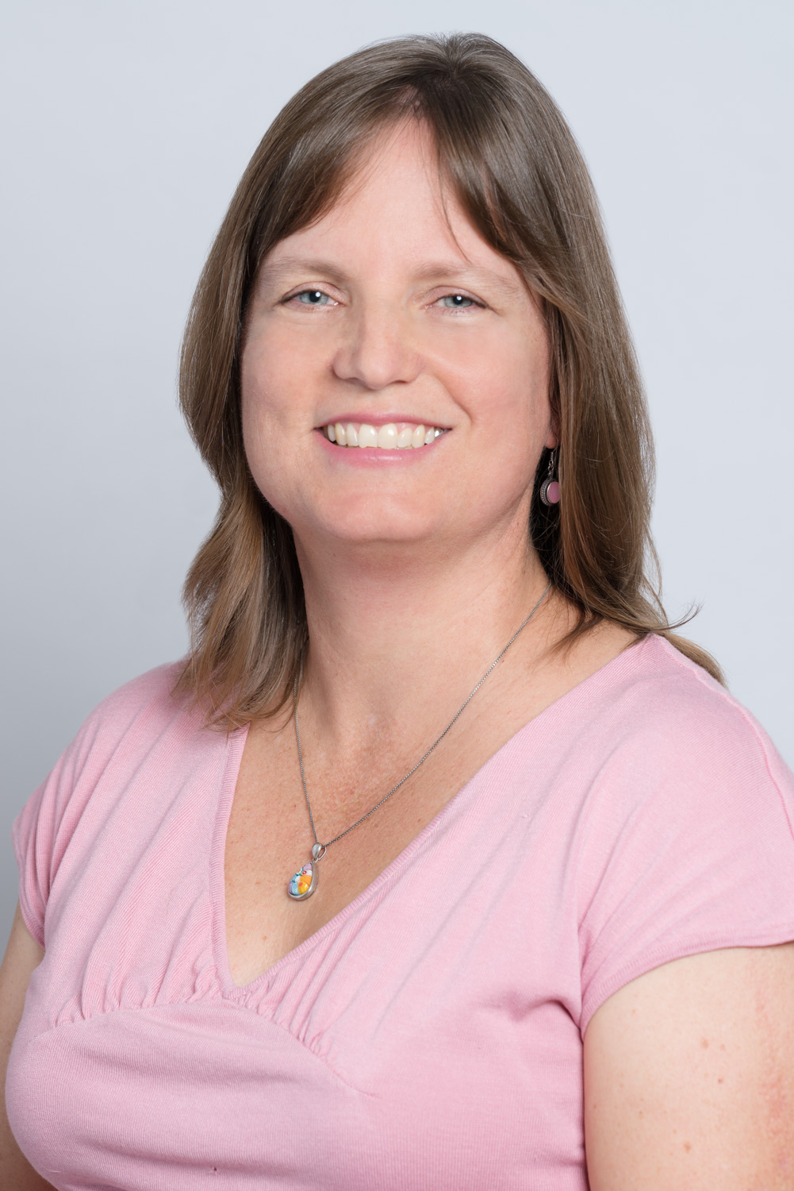
Program Coordinator: Dr. Jean Snell

Slide 3
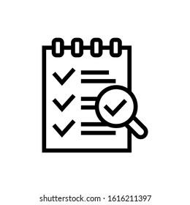
Program Standards
Our Agenda
Program Overview
UMD Eligibility & Application Process

Slide 4
Program Standards

Slide 5
Our Purpose
Education is for improving the lives of others and for leaving your community and world better than you found it.
Marian Wright Edelman
Education is the most powerful weapon which you can use to change the world.
Nelson Mandela

Slide 6
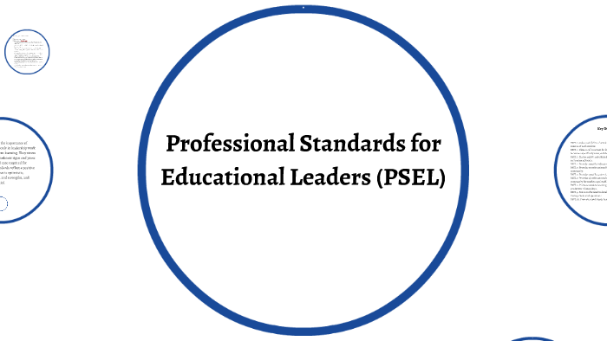
The Program Anchor
To download the full PSELs Report: https://www.npbea.org/psel
Notes:
Please see MSDE website for the full description of the PSELs here.

Slide 7
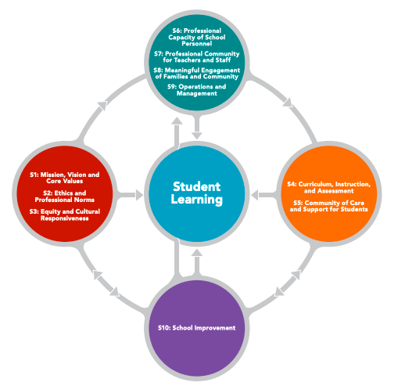
PSEL Overview: The Relationship of School Leadership to Student Learning
Notes:
The Professional Standards in Educational Leadership embody a research- and practice-based understanding of the relationship between educational leadership and student learning.” Improving student learning takes a holistic view of leadership. In all realms of their work, educational leaders must focus on how they are promoting the learning, achievement, development, and well-being of each student. The Standards reflect interdependent domains, qualities and values of leadership work that research and practice suggest are integral to student success.
MSDE categorize them as clusters into 4 groups: The Drivers, The Core, The Supports and The Anchor

Slide 8
Improvement science is explicitly designed to accelerate learning-by-doing. It’s a more user-centered and problem-centered approach to improving teaching and learning.
- Carnegie Foundation for the Advancement of Teaching

Slide 9
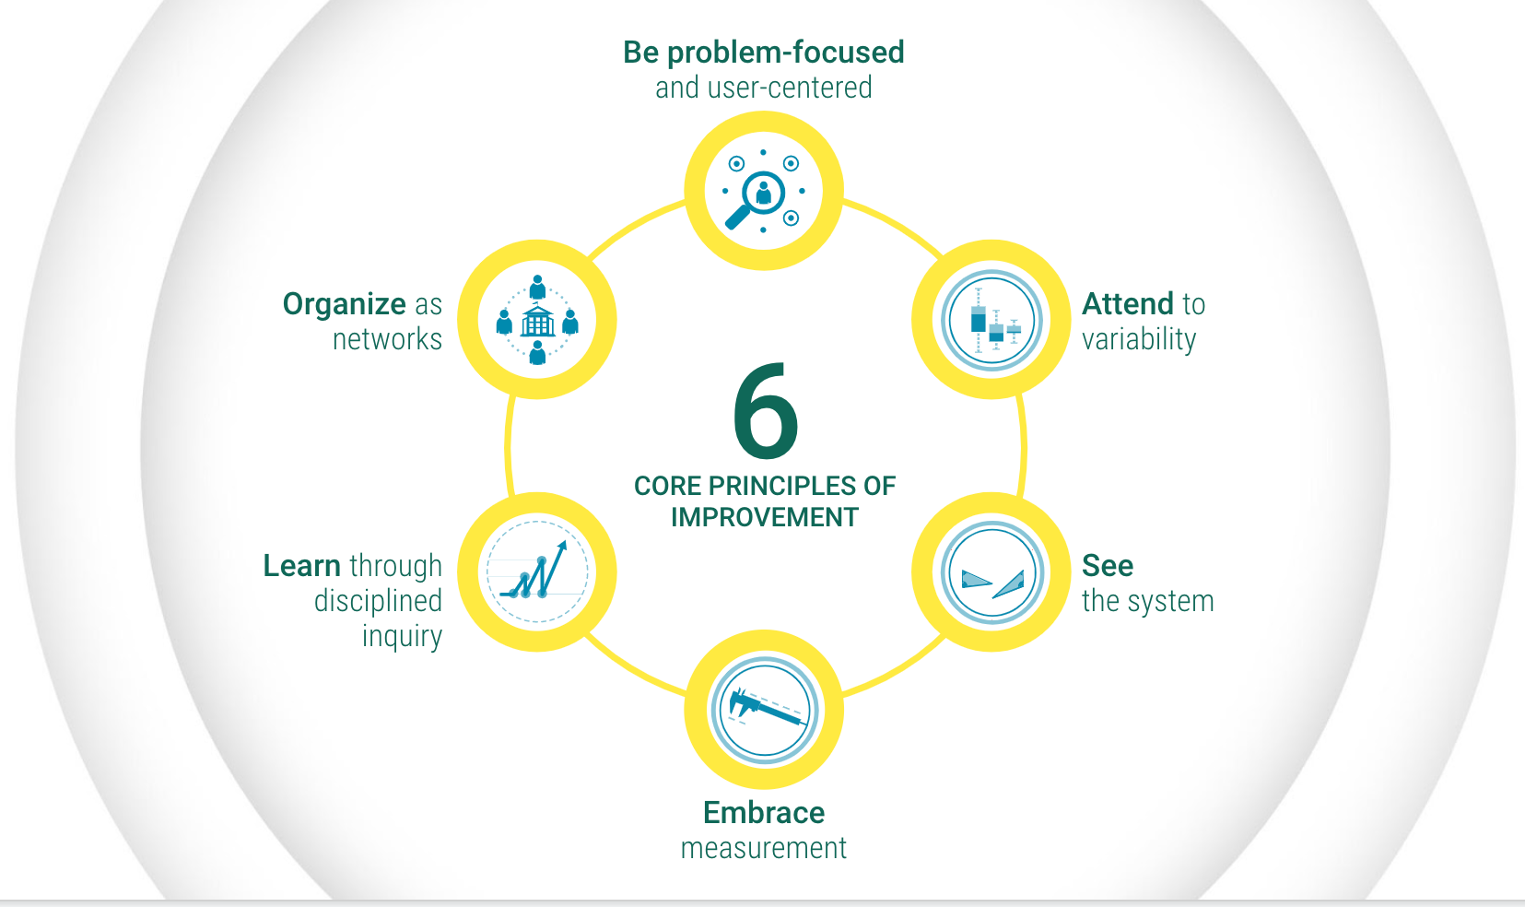
Source: Carnegie Foundation for the Advancement of Teaching

Slide 10
Program Overview

Slide 11
Program Highlights
16 month/4 semester program (Sept 2022-Dec 2023)
5 courses + Internship = 18 credits total
Fully online model w/weekly synchronous class sessions
Focused on Equity and Improvement Leadership
6-month supervised home school-based Internship (July - Dec, 2023)
Culminating Leadership Portfolio (includes course assignments)

Slide 12
Admin 1 Course Sequence*
EDUC 640 Introduction to Educational Leadership (Fall 2022) | PSEL #1
EDUC 670 Learning Communities (Fall 2022) | PSELs #7 & 8
EDUC 646 Leading Instructional Excellence (Spring 2023) | PSEL #4
EDUC 645 Leading Instructional Improvement (Spring 2023) | PSEL #6
EDUC 671 Education Law, Finance, & Policy (Summer I 2023) | PSELs #9 & 5
*PSELs #2, 3, & 10 are woven throughout all courses

Slide 13
EDUC 640: Introduction to Educational Leadership
Aspiring Leaders will be introduced to the PSELs as the standards which anchor effective school leadership, and will examine how a school’s vision/mission and the value of equity guide school improvement leadership. Candidates will be introduced to the Problem of Practice as a cornerstone of continuous improvement.

Slide 14
EDUC 670: Learning Communities
Aspiring Leaders will explore how families and community members are important stakeholders to student learning and school success, and how school leaders can foster a collaborative learning community among their teachers and staff. Candidates will also be introduced to Causal Systems Analysis.

Slide 15
EDUC 646: Leading Instructional Excellence
Aspiring Leaders will examine how to engage the pillars of curriculum, instruction, and assessment to foster high quality teaching and learning conditions across a school. Candidates will continue to explore the role of Causal Systems Analysis in developing their Problem of Practice.

Slide 16
EDUC 645: Leading Instructional Improvement
Aspiring Leaders will explore a range of best practices in Instructional Leadership, including observation and feedback, and facilitating collaborative learning and professional development. Candidates will be introduced to Driver Diagrams and Theory of Improvement.

Slide 17
EDUC 671: Education Law, Finance, and Policy
Aspiring Leaders will explore best practices in school management and operations, including budgeting, policy & legal compliance, and oversight of the physical plant. Candidates will continue to develop their Theories of Improvement and advancing their Problems of Practice.

Slide 18
Admin 1 Internship: EDUC 689
Start Date: July 1 2023
Duration: 6 months
240 Internship Hours total required by MSDE
Internship Course (EDUC 689) includes monthly practicum cohort meetings
Candidates will work closely with school-based Mentor and University Supervisor
Framed around compiling experiences and evidence needed to complete your Leadership Portfolio

Slide 19
UMD School Leadership Portfolio
Organized around Professional Standards for Educational Leaders (PSEL)
Course assignments are aligned with PSEL indicators
Candidates collect 3+ artifacts per PSEL standard from Teacher Leadership and Internship activities
December 2023: Intern submit portfolios for formal review

Slide 20
Candidate Eligbility and UMD Admissions Process

Slide 21
UMD Eligibility Criteria
Minimum 4-years of classroom teaching (and current MD teaching license)
Demonstrated Teacher Leadership
Earned Master’s degree in Education
3.0 UG GPA; 3.5 Graduate GPA (UMD required)
Active support/endorsement of School Administration (Internship placement and Mentor)

Slide 22
UMD Application Requirements
Current Resume
Letter of Recommendation from current Principal
Statement of Purpose
3-credit SPED course
UG, Grad, and Certification transcripts
Application Fee ($75.00)
No Test requirement*
Application Deadline: June 10th
*TOEFL required when degree is not from U.S. university
Notes:
Step by Step guide to UMD Graduate Application: https://gradschool.umd.edu/admissions/application-process/step-step-guide-applying

Slide 23
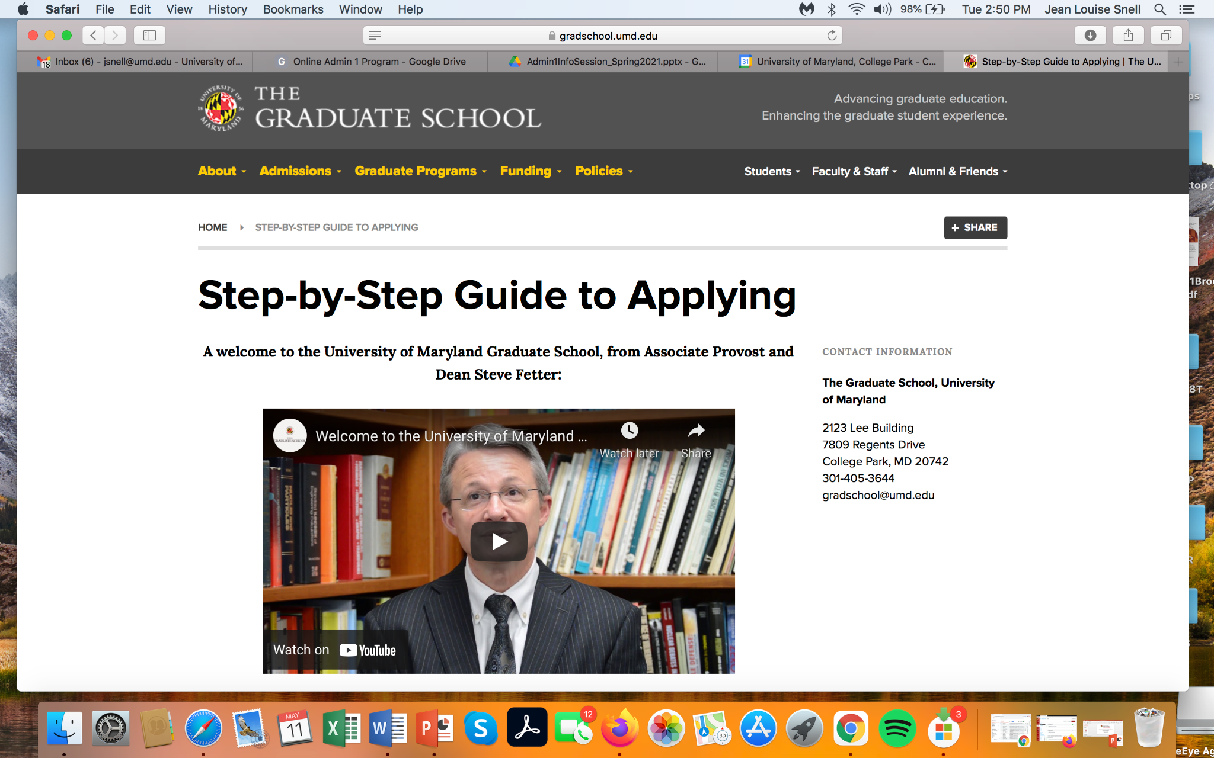
Applying to the UMD Graduate School
Step by Step guide to UMD Graduate Application: https://gradschool.umd.edu/admissions/application-process/step-step-guide-applying
Notes:
Step by Step guide to UMD Graduate Application: https://gradschool.umd.edu/admissions/application-process/step-step-guide-applying

Slide 24
Tips for Applying to UMD
Unofficial transcripts are OK for initial application (will need official transcripts from all institutions by end of 1st semester in program)
SPED course can be from UG or Grad program, or a standalone class (need separate transcript if standalone); can be admitted provisionally if unfulfilled
Use Program code Z138 to apply to the School Improvement Leadership Post-Baccalaureate Certificate (PBC) Program
Please email Judy Foster with any application questions: jfoster@umd.edu

Slide 25
Creating a Financial Plan
UMD Admin 1 Certification PBC = 18 credits
Total cost approximately = $14,000
Tuition billing follows course registration
(per semester or per course)
Private graduate loans available only
Most districts offer partial reimbursement only once grades are posted on transcript
UMD Graduate Tuition rates: https://billpay.umd.edu/GraduateTuition
Notes:
For a listing of the current per credit UMD graduate costs, see here.

Slide 26
Program Contact: Dr. Jean Snell jsnell@umd.edu

