Slide 1

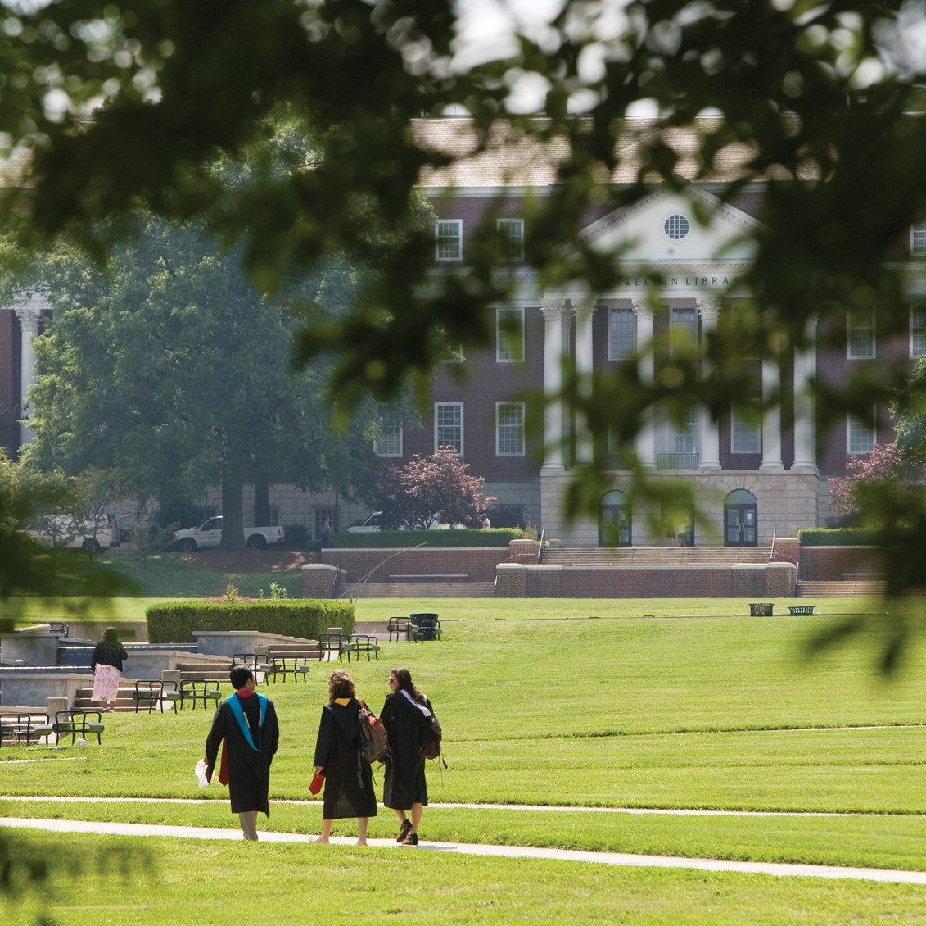




SPARC
Support Program for Advancing
Research and Collaboration

Slide 2

Support Program for Advancing Research and Collaboration
Doctoral Candidate Program

Slide 3

Goals of SPARC?
Assist student with the costs associated with completing their dissertation research.
Introduce students to the grant proposal process from preparation and submission through review and funding.

Slide 4

Who is eligible to receive a graduate SPARC award?
Doctoral student:
in good standing and planning to advance to candidacy by the next semester
who has advanced to candidacy
conducting research directly related to the dissertation

Slide 5
Preparing a SPARC proposal
Application requirements:
Abstract
Project Description
Budget
Budget Narrative
Biosketch
Letter of Support from Advisor or Department Chair

Slide 6
Preparing a SPARC proposal (cont.)
Download all forms first and create a plan for the proposal and contact your advisor.
Follow all application and formatting guidelines
Use the bulleted requirements under sections “Significance” and “Research Plan” to develop the project description.
Use guidelines for length, font, and correct document type
Use templates for budget, budget narrative, biosketch, and letter of support.

Slide 7
Budget and Budget Narrative
List your reasonable expenditures and costs.
Consider everything; talk through your project with other students and your advisor
Unanticipated costs arise so think it through
Travel to schools
Reimbursement to schools
Software licenses
Audio recorders or video equipment
Illustrator costs for stimuli
Workshop participation

Slide 8
Biosketch
NSF format
Geared for a faculty member, but fill out what is relevant to you
Honors, awards
Positions: graduate student assistantships; other research positions.
Publications: papers under review; in press
Conference papers
Proofread!

Slide 9
Letter of Support
Use the provided template
To be completed by advisor or department chair
Should indicate support for proposed project
Should confirm candidacy or indicate approximate date by which applicant will advance to candidacy
Advisor or department chair should email to coe_sparc@umd.edu

Slide 10
SPARC Grant Review Process
All applications are screened prior to review to ensure each application is complete and all requirements have been met.
Three faculty members, representing each of the departments, independently review and evaluate applications using a review form.

Slide 11
SPARC Grant Review Process (cont.)
All applications are scored on how well the applicant answers the questions stated in the project description guidelines.
Significance and Research Plan sections of the project description are scored on a 1 (poor) to 7 (excellent) scale.
The proposal is also given a summary score indicating if it is recommended for funding.

Slide 12
SPARC Grant Review Process (cont.)
Committee decision and feedback is provided to the Associate Dean, who prepares the award letters.
If revisions are required, students may resubmit and the resubmission is reviewed by the Associate Dean and/or selected members of the review committee.
Awardee Process – grant award letter is issued and funds are distributed directly into the student account.

Slide 13
Questions?
SPARC Website
Contact COE Research coe_sparc@umd.edu with any questions
Good luck and happy writing!

Slide 14


College of Education
University of Maryland
College Park, Maryland 20742-1121
301.405.2334 education.umd.edu

